Slide 3
1) One more than is
2) How do spell the number 3?
3)
4) How old is Annie?
+
=

Slide 4
1) One more than is
2) How do spell the number 3?
3)
4) How old is Annie?
3
three
+
=
5
7

Slide 6
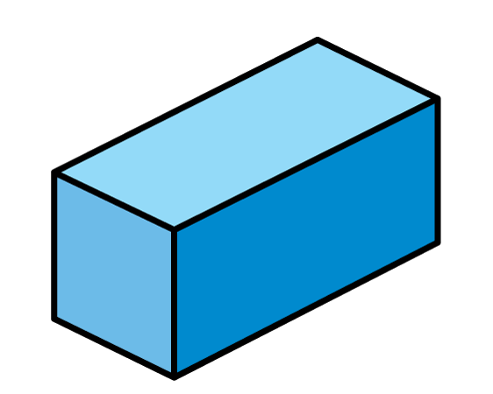
Recognise and name 3-D shapes

Slide 7
What shape is this?
Cube

Slide 8
Which of these shapes are cubes?
Have a think

Slide 9
What shape is this?
Cylinder

Slide 10
Which of these shapes are cylinders?
Have a think

Slide 11
What shapes can you see?
Have a think
Cone
Sphere
Pyramid
Cylinder
Cube
Cuboid

Slide 12
Have a think
Pyramid
Cuboid
Cube
Cone
Sphere
1
2
1
What shapes did Whitney use?

Slide 13
Have a think
Cylinder
Cuboid
Cube
Cone
Sphere
2
2
1
What shapes did Teddy use?

Slide 14
Have a think
Cylinder
Cuboid
Cube
Cone
Sphere
1
1
2
What shapes did Tommy use?

