Slide 3
1) How many candles?
2) How do you spell 5 ?
3) Put these in order from smallest to greatest 3 9 2
4) Put these in order from greatest to smallest 3 9 2

Slide 4
1) How many candles?
2) How do you spell 5 ?
3) Put these in order from smallest to greatest 3 9 2
4) Put these in order from greatest to smallest 3 9 2
6
f-i-v-e
2, 3, 9
9, 3, 2

Slide 6
Ordinal numbers
1st
second
2nd
third
3rd
fifth
4th
first
5th
fourth

Slide 7
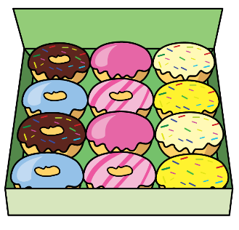
Let’s use ordinal numbers!
1st
2nd
3rd
4th
5th
6th

Slide 8
Have a think
Let’s use ordinal numbers!
1st
3rd
5th

Slide 9
Have a think
Which triangles are coloured in?
1st
2nd
4th

Slide 10
Have a go at questions 1 and 2 on the worksheet

Slide 11
What birthday are they celebrating?
It’s my fourth birthday!
It’s my third birthday!
Which cake will they have?

Slide 12
Have a go at question 3 on the worksheet

Slide 13
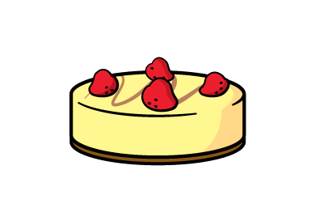
First and last
first
last

Slide 14
It’s a race!
3… 2… 1… GO!
Have a think
Who finished 1st?
Who finished last?

Slide 15
Have a go at the last question on the worksheet

