Slide 3
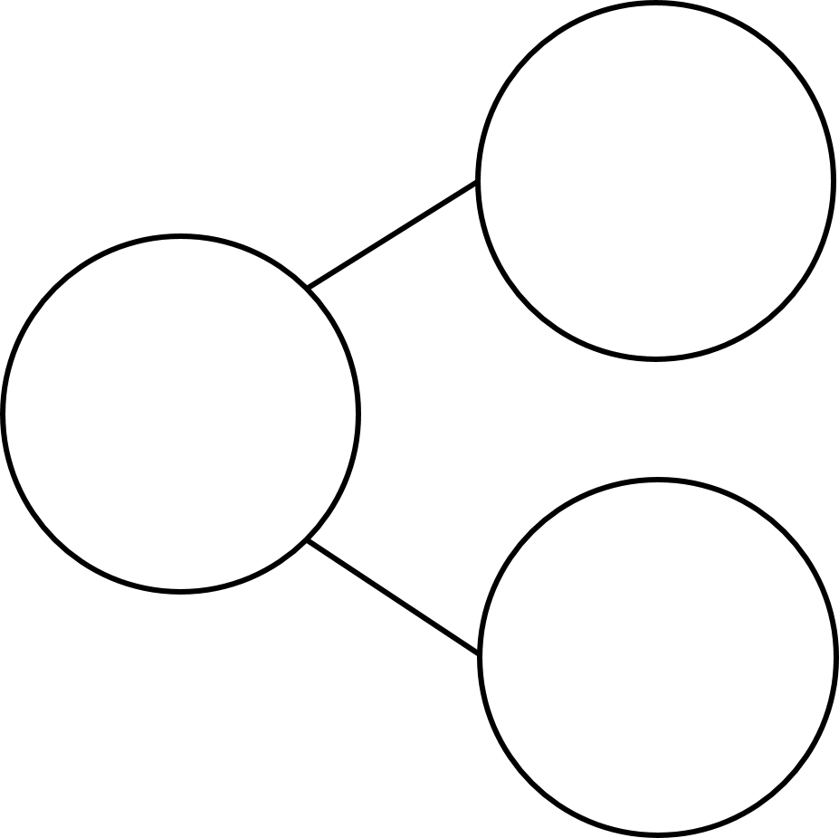
1) One less than is
2) Count backwards from 9 to 5
3) How do spell the number 4?
4) What number is missing?
5
7

Slide 4
1) One less than is
2) Count backwards from 9 to 5
3) How do spell the number 4?
4) What number is missing?
7
9, 8, 7, 6, 5
four
5
7
2

Slide 6
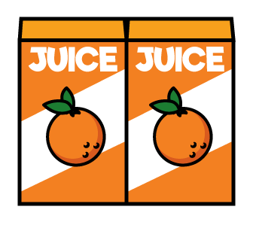
Subtraction – Taking away
6
First there were juice boxes.
1
Then Amir drank juice box.
5
Now there are juice boxes.

Slide 7
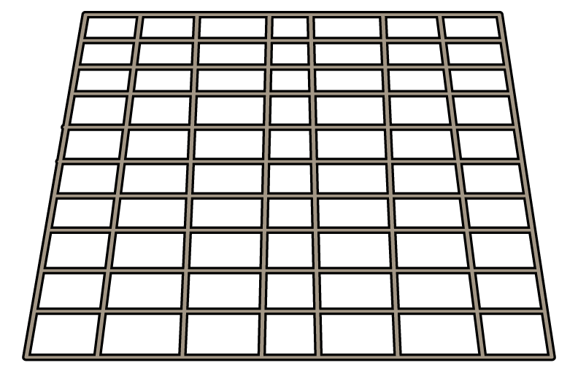
Subtraction – Taking away
Have a think
First there were cupcakes.
9
Then Chase ate cupcakes.
2
7
Now there are cupcakes.

Slide 8
First there were bees on the hive.
7
Then flew away.
3
Now there are bees on the hive.
4

Slide 9
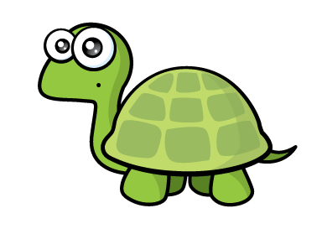
Have a think
Happy 10th Birthday Tiny!
Time to blow out your candles.
Can you tell a subtraction story?

Slide 10
Have a think
Happy 10th Birthday Tiny!
First there were candles.
10
Then Tiny blew out candles.
6
Now there are candles still lit.
4

