Slide 3
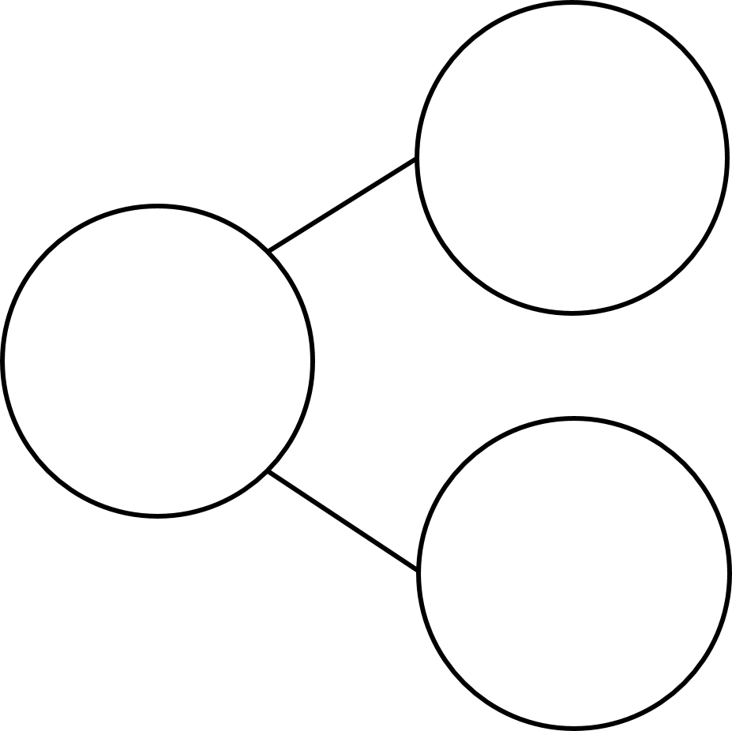
1) One less than is
2) Count backwards from 7 to 3
3) How do spell the number 9?
4) What number is missing?
3
7

Slide 4
1) One less than is
2) Count backwards from 7 to 3
3) How do spell the number 9?
4) What number is missing?
6
7, 6, 5, 4, 3
nine
3
7
4

Slide 6
Subtraction – taking away
Happy 10th Birthday Tiny!
10
$$−$$
6
$$=$$
4

Slide 7
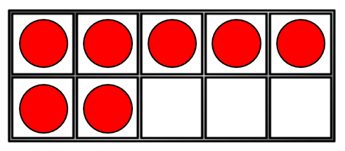
Subtraction – taking away
7
$$−$$
3
$$=$$
4
7
$$−$$
5
$$=$$
2
I can show subtraction by crossing out!

Slide 8
Have a think
Mo, Eva and Amir all get off at the next stop.
How many children are left on the bus?
8
$$−$$
3
$$=$$
5

Slide 9
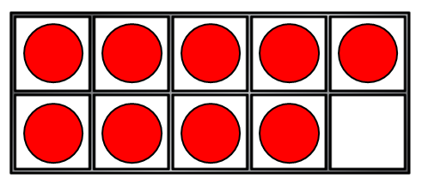
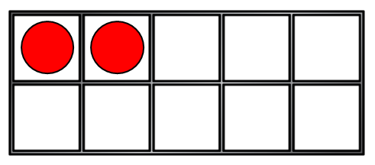
Have a think
First Then Now
9
$$−$$
2
$$=$$
7
9
$$−$$
7
$$=$$
2

Slide 10
Have a think
$$−$$
4
$$=$$
6
?
2
10
$$−$$
5
$$=$$
?
5
$$−$$
3
$$=$$
3
?
0
$$−$$
?
$$=$$
7
6
1
0 | 1 | 2 | 3 | 4 | 5 | 6 | 7 | 8 | 9 | 10

