Slide 3
1) What is one less than 10?
2) What is take away
3) If 7 $−$ 3 = 4, then 7 $−$ 4 =
4) What is 8 $−$ 2 =

Slide 4
1) What is one less than 10?
2) What is take away
3) If 7 $−$ 3 = 4, then 7 $−$ 4 =
4) What is 8 $−$ 2 =
9
3
3
6

Slide 6
Fiona picked some flowers.
Fiona
7
4
How many more blue flowers are there than orange flowers?
3

Slide 7
Finding the difference.
5
3
How many more fish did Ron catch than Teddy?
2

Slide 8
Finding the difference.
Have a think
Ron
5
?
3
Teddy
How many fewer fish did Teddy catch than Ron?
2

Slide 9
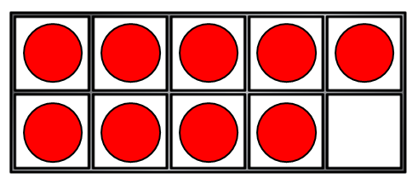
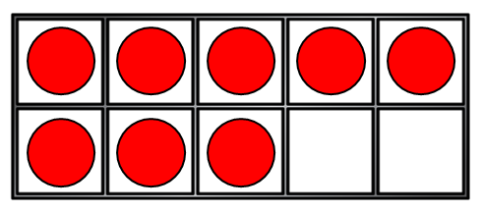
What is the difference between these ten frames?
9
$$−$$
8
$$=$$
1

Slide 10
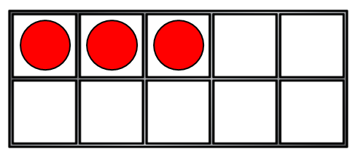
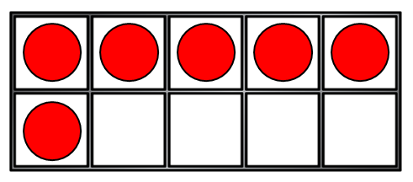
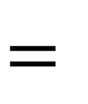
Have a think
What is the difference between these ten frames?
6
$$−$$
3
$$=$$
3

Slide 11
Have a think
What is the difference between these windows?
10
$$−$$
8
$$=$$
2

