Slide 1
Basic functions of the ear

Slide 2
Whole class discussion…

Slide 3
What is the ear and how do we hear?
https://www.youtube.com/watch?v=mptjEoHF2aI

Slide 4
The Video asked you a question….
How many parts is the ear divided up into?
Show me your understanding…

Slide 5
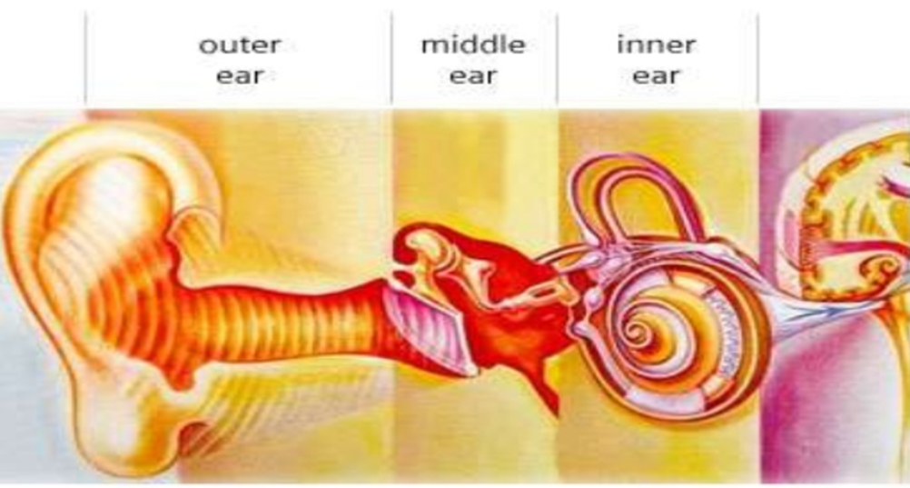

Slide 6
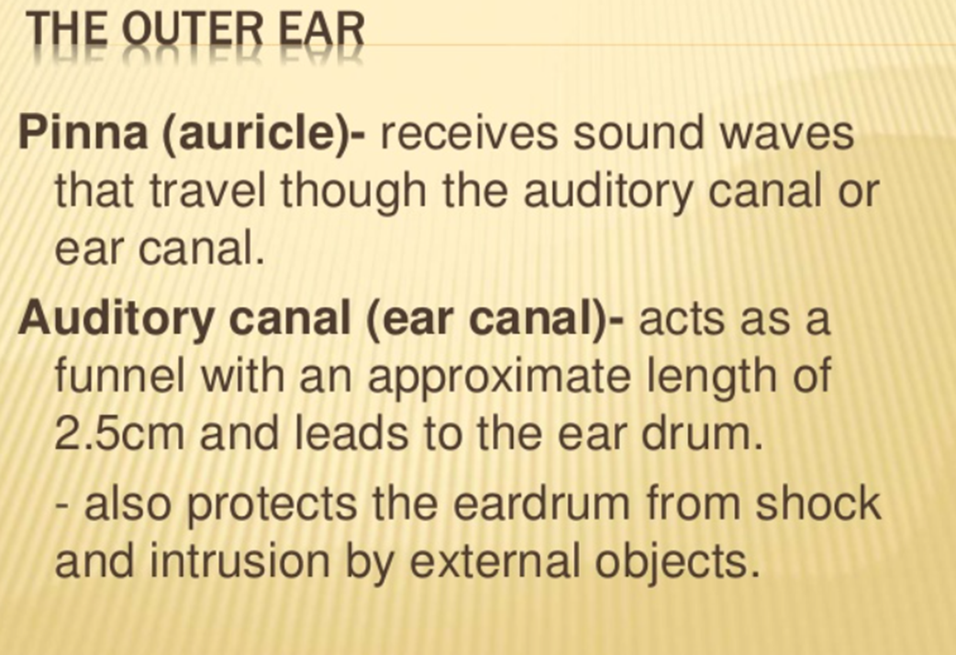

Slide 7
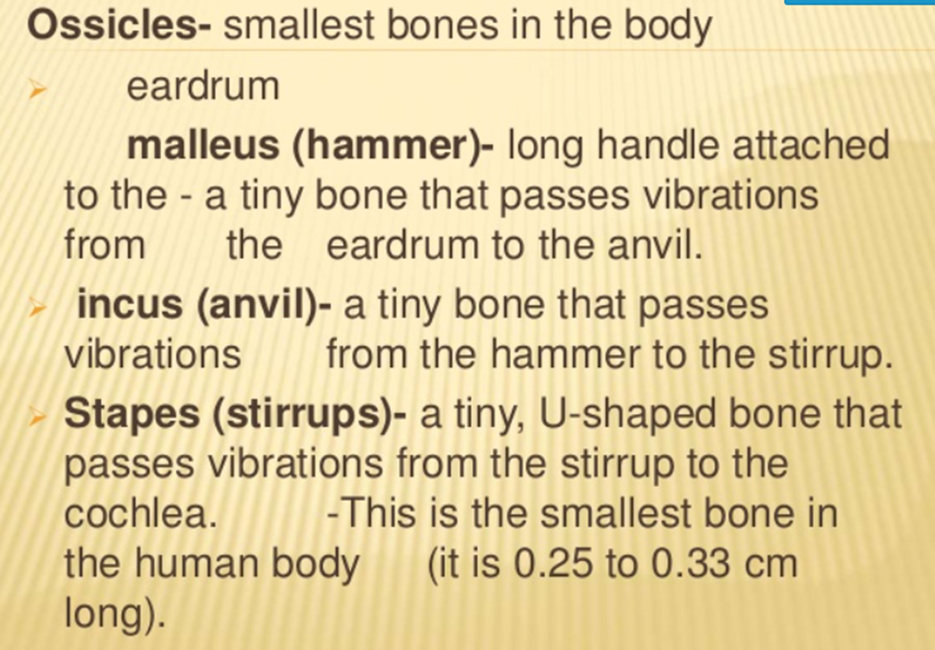

Slide 11
These statements about how we hear are jumbled up. You need to write them in the correct order.
The vibrations pass along the auditory nerve to your brain.
The ear-drum vibrates when a sound hits it.
Your brain sorts the message and you hear the sound.
Your outer ear channels the sound waves into your ear.
The vibrating ear-drum makes the little bones in your ear vibrate.
The sound waves travel along the auditory canal.

Slide 12
These statements about how we hear are jumbled up. You need to write them in the correct order.
Order Number | Statement
5 | The vibrations pass along the auditory nerve to your brain.
3 | The ear-drum vibrates when a sound hits it.
6 | Your brain sorts the message and you hear the sound.
1 | Your outer ear channels the sound waves into your ear.
5 | The vibrating ear-drum makes the little bones in your ear vibrate.
2 | The sound waves travel along the auditory canal.

Slide 13
Let’s check our understanding…..
The _______________ is used for hearing. It is split into 3 sections:
1) ______________________________________
2) _____________________________________
3) _____________________________________
______________________ waves travel from the outer ear to the
_______________ ear and are then transmitted to the inner ear.
The compressional waves are then sent from the inner ear to the _____________.

Slide 14
How did we work today?

