Slide 1
Week beginning 4.1.21
Spelling
Doubling consonants or not

Slide 2
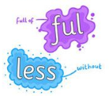
Spelling Reminders
A root word is a basic word with nothing added to it e.g. forget.
A suffix is a string of letters that go at the end of a word e.g. ing.
Forget

Slide 3
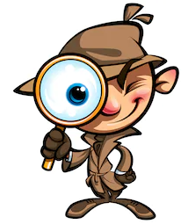
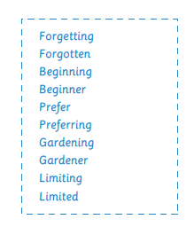
Lesson 1
For each of these pair of words identify the root word and the suffix.
Is there a rule?
See the next slide.

Slide 4
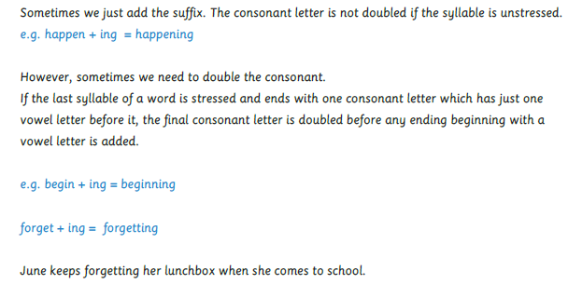

Slide 5
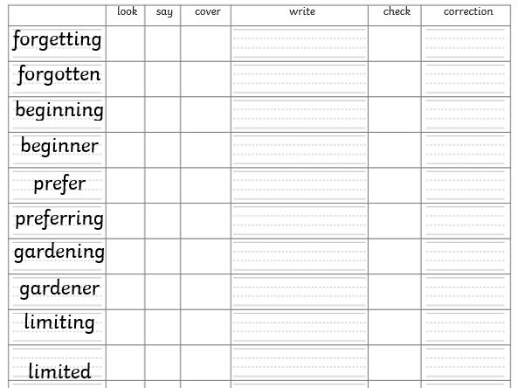
Look at each word in turn.
Next cover the word with your finger.
Now write it out in your neatest writing.
Check your spelling.
If correct, tick it. If incorrect, rewrite correctly in purple pen.

Slide 6
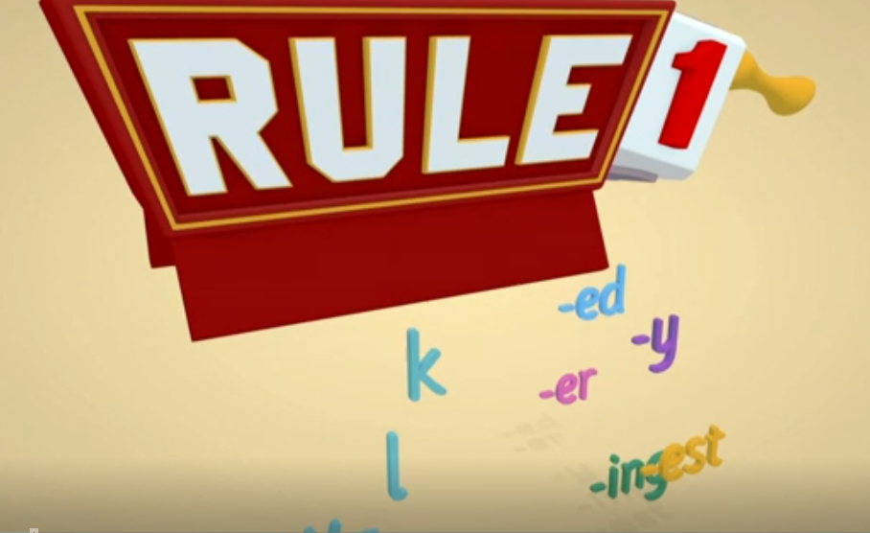
Lesson 2
Let’s find out about the 4 spelling rules for adding suffixes.
https://www.bbc.co.uk/teach/class-clips-video/english-ks2-wonderful-words-suffixes-part-1/zdnd7nb

Slide 10
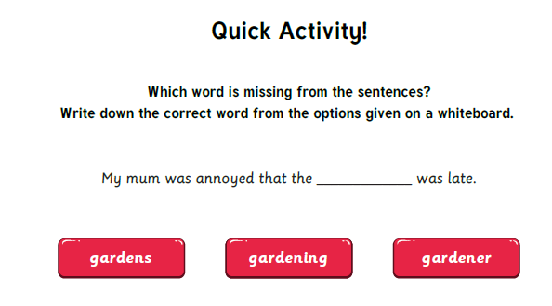

Slide 11
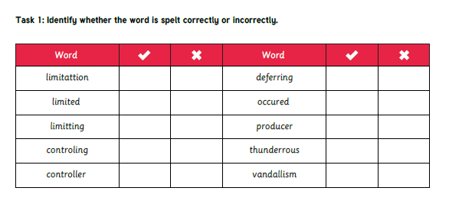
You will need page 3 of the spelling booklet.

Slide 12
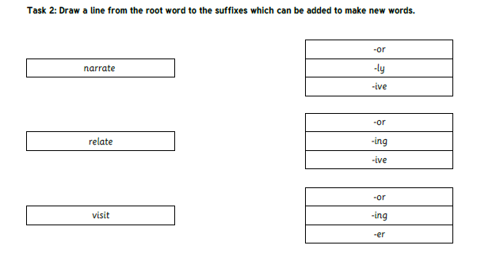

Slide 13
Plenary
Let’s play Spooky Spellings and learn some Year 3 and 4 common exception words
http://www.ictgames.com/mobilePage/spookySpellings/index.html
Today, we are looking at the words in book 4.

Slide 14
Lesson 3
Starter
Use the spelling rule for words using the prefixes dis and mis to help you learn them.
Is there a spelling rule I should use to help me learn these words?

Slide 15
Today, we will be testing our knowledge of this week’s spellings.
In your jotter spend some time practising these spellings.
You can use:
rainbow letters,
create a spelling picture
identify the tricky part and write it in a different colour
you can break the word down into chunks.
look to see if there are smaller words inside the word.
Is there a spelling rule I can use to help me?

Slide 16
Now let’s test your spelling knowledge.
Are you ready?

Slide 17
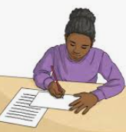
Plenary
If there are any words that you got wrong then write them out correctly using your purple pen.

