Slide 1
EYFS Maths
Week beg: 19th October
Number 1 - 10

Slide 2
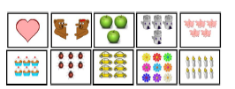
Monday 19th October
Hide some numerals outside. Children run to find a numeral – can you find a partner with the same numeral? Can you say which number you have found? Can you group yourselves with the same number? How many children holding a 3?
Mix up cards with different objects on from 1 object to 10 objects. Can you arrange them from smallest to largest? Largest to smallest?

Slide 3
Tuesday 20th October
Have lego towers of 1 – 10 made. Give children number cards 1 – 10.
Can the children match up the correct numeral with each lego tower.

Slide 4
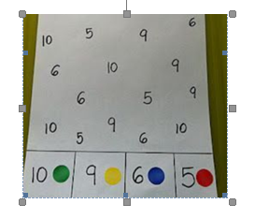
Wednesday 21st October
Play snap! Children are given the same amount of cards (with pictorial representation and numerals on). They turn them over one at a time. If two cards, that are equal, are placed down in a row you can put your hand on top and shout ‘snap’.
Have numbers 1 – 10 on paper. Place a sticker over or colour in number when said or rolled on a dice.

