Slide 1
EYFS Maths
Week beg: 12th October
Number 1-10

Slide 2
Monday 12th October
Count forwards to 10.
Count back from 10. Use a number line to support
Have sets of numbers to 10. Children work in small groups. Can they order them? Which number comes after 5? Before 9?

Slide 3
Tuesday 13th October
Sing 10 green bottles.
Demonstrate partner work. Pick a number then partner does that many jumps / hops / wiggles etc. Children work in pairs. Focus on numbers 6-10.
Use chalk outside. Say a number form 1-10. Can you write that number?
Sue number line to support.

Slide 4
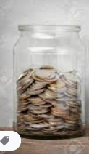
Wednesday 14th October
Sing 1, 2, 3, 4, 5, - are you saying numbers forwards or backwards?
Have a jar and money coins. Close eyes how many coins dropped in my jar? Children show on fingers / number fan.
If I added one more in my jar how many would there be?

Slide 5
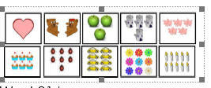
Thursday 15th October
Picture cards of objects 1-10 and number cards 1 – 10.
Can you match to correct numeral.
Can you place them in ascending order.

Slide 6
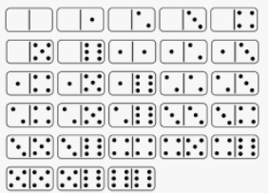
Friday 16th october
Numberline 1 – 10. Find numbers: 6, 4, 7, 8, 10.
Use dominoes, Can you find me a six domino. A 7 domino.
Maybe introduce 6 and 1 is 7 etc.

