Slide 1
EYFS phonics
Recap sounds:
h, b, f, ff, l, ll j, v, w, x

Slide 2
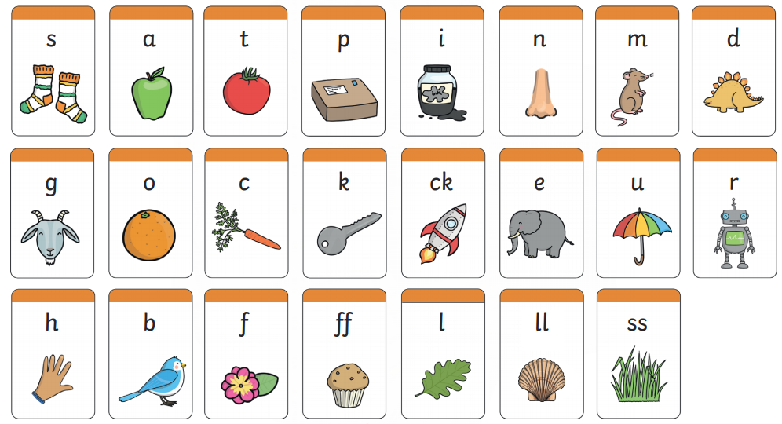
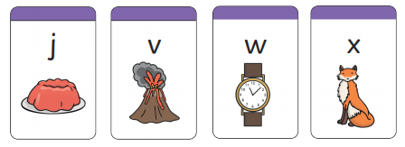
Recap: Can you remember these sounds?

Slide 3
H h
use your finger to write a ‘h’ in the air, then practise with your pencil.
Can you sound out and blend these h words?
h a t hat
h a m ham
h i l l hill
Watch the wizards read h words:
https://www.bbc.co.uk/bitesize/topics/zf2yf4j/articles/zvhvy9q

Slide 4
B b
use your finger to write a ‘b’ in the air, then practise with your pencil.
b, b, b… bat b, b, b… bin b, b, b… bun
Watch alphablocks word magic ‘b’:
https://www.bbc.co.uk/iplayer/episode/p0872ymg/alphablocks-magic-words-2-meet-alphablock-b
Go on a spy walk, what ‘b’ items can you spot?

Slide 5
Ff, ff
use your finger to write a ‘f’ in the air, then practise with your pencil.
Can you find all five ‘f’ items in the picture?
With your pencil, write the words:
huff puff off

Slide 6
Ll, ll
use your finger to write a ‘l’ in the air, then practise with your pencil.
Go on a spy walk, what ‘l’ items can you spot?
Match the ‘ll’ words with the pictures.
ball bell ill doll

Slide 7
J j
use your finger to write a ‘j’ in the air, then practise with your pencil.
Can you read sound out and blend these j words?
j e t jet
j a m jam
j u m p jump
Watch the wizards read j words:
https://www.bbc.co.uk/bitesize/topics/zvq9bdm/articles/zv3cy9q

Slide 8
V v
use your finger to write a ‘v’ in the air, then practise with your pencil.
v, v, v… van v, v, v… vet v, v, v… vest
Watch alphablocks word magic ‘v’:
https://www.bbc.co.uk/iplayer/episode/p0873159/alphablocks-magic-words-22-meet-alphablock-v
Can you think of a sentence using a ‘v’ word?

Slide 9
W w
use your finger to write a ‘w’ in the air, then practise with your pencil.
Can you hear the ‘w’ in these objects? Name each item emphasising the ‘w’ sound.
Learn the jolly phonics ‘w’ song:
https://www.youtube.com/watch?v=PlDPegyV6XI

Slide 10
X x
use your finger to write a ‘x’ in the air, then practise with your pencil.
Can you hear the ‘x’ in these objects? Name each item emphasising the ‘x’ sound.
Listen to the ‘x’ sound song:
https://www.bbc.co.uk/cbeebies/watch/cbeebies-house-alphabet-songs-x
ox box fox

Slide 11
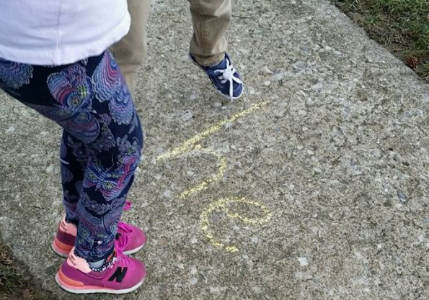
Sight words
Sight words break the rules. They can not be sounded out. We just have to learn what they look like.
to
go
no
so
Write sight words on the floor with chalk or on paper. Can you say each one as you jump on it?

Slide 12
Sight word splat- Ask your grown up to point to a sight word and see how quickly you can point to it.
to go
no so
the I

Slide 13
Useful website games:
https://lettersandsounds.org.uk/for-home/reception
https://www.phonicsplay.co.uk/resources/phase/2/pick-a-picture (phonics play, phase 2, pick and picture set 1-5)
https://www.phonicsbloom.com/uk/game/odd-and-bob?phase=2 (phonics bloom, phase 2, odd and bob, set up to r)
Alphablocks videos:
https://www.youtube.com/watch?v=VxBEmaaSh1c
https://www.youtube.com/watch?v=WD4-vPkeIqs

