Slide 1
EYFS phonics

Slide 2
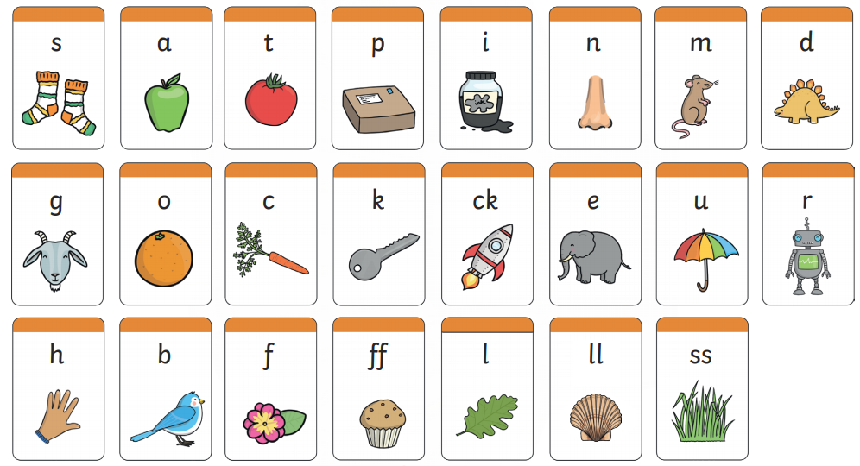
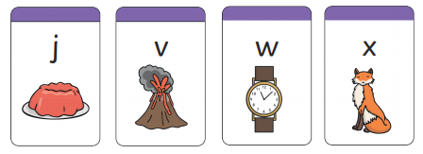
Recap: Can you remember these sounds?

Slide 3
Monday
Put these sounds on the floor. Jump to each one, saying the sound as you land, then blend together to make the word.
h a t hat
b i t bit
f i ll fill
Buried treasure- revise all phase 2
https://www.phonicsplay.co.uk/resources/phase/2/buried-treasure
Use your finger to write a h, b and f in the air, then with your pencil.

Slide 4
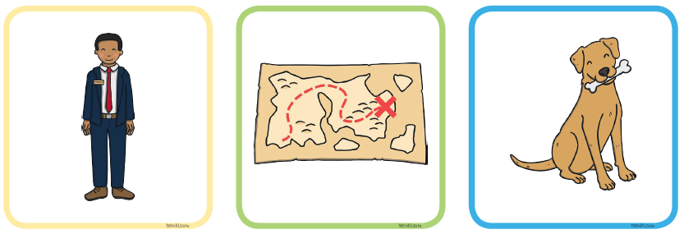
Tuesday
Sound out the words and match them to the picture.
Challenge- Can you hide the words and label the pictures
yourself?

Slide 5
Wednesday
Word hunt-
Ask your grown up to write these words and hide them around the room. Can you find them and read them?
man well puff hot box van
Dragon’s den revise all phase 2-
https://www.phonicsplay.co.uk/resources/phase/2/pick-a-picture
Use your finger to write a h, b and f in the air, then with your pencil.

Slide 6
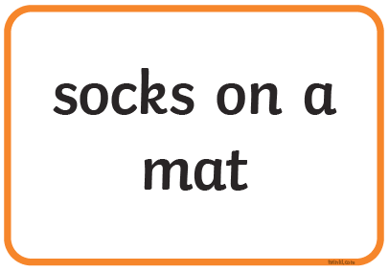
Thursday
Using your pencil, write the words: fog, hat, mud, carrot, rocket
Read the captions and draw a picture for each one.

Slide 7
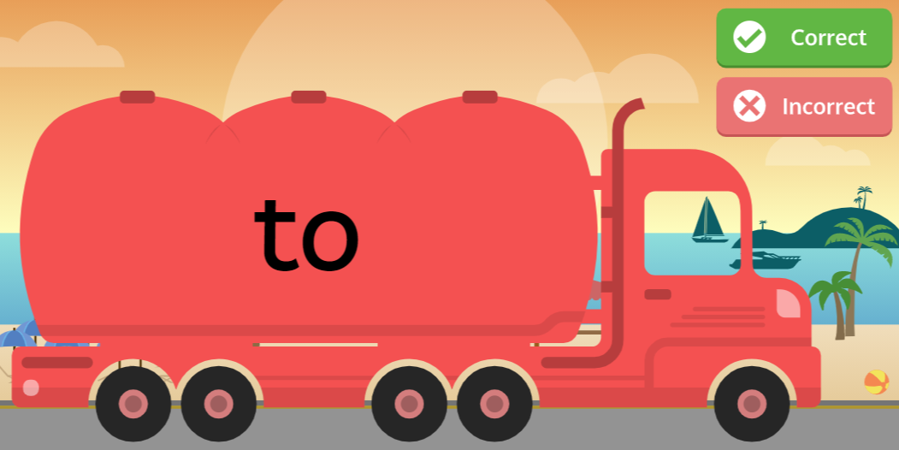
Friday
Sight word recognition- play Tricky Word Trucks on Phonics Play.
https://www.phonicsplay.co.uk/resources/phase/3
Listen to the wizard’s tricky words song:
https://www.bbc.co.uk/bitesize/topics/zf2yf4j/articles/zdrd8xs

Slide 8
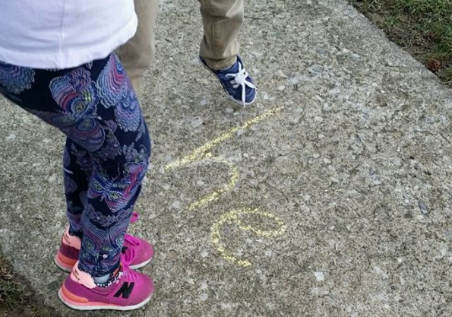
Sight words
Sight words break the rules. They can not be sounded out. We just have to learn what they look like.
the
I
to
go
no
so
Write sight words on the floor with chalk or on paper. Can you say each one as you jump on it?

Slide 9
Useful website games:
https://lettersandsounds.org.uk/for-home/reception
https://www.phonicsplay.co.uk/resources/phase/2/pick-a-picture (phonics play, phase 2, pick and picture set 1-5. Username- march20, password- home)
https://www.phonicsbloom.com/uk/game/odd-and-bob?phase=2 (phonics bloom, phase 2, odd and bob, set up to r. Username- march20, password- home)
Alphablocks videos:
https://www.youtube.com/watch?v=VxBEmaaSh1c
https://www.youtube.com/watch?v=WD4-vPkeIqs

