Slide 1
EYFS phonics
Focus sounds; y z zz qu

Slide 2
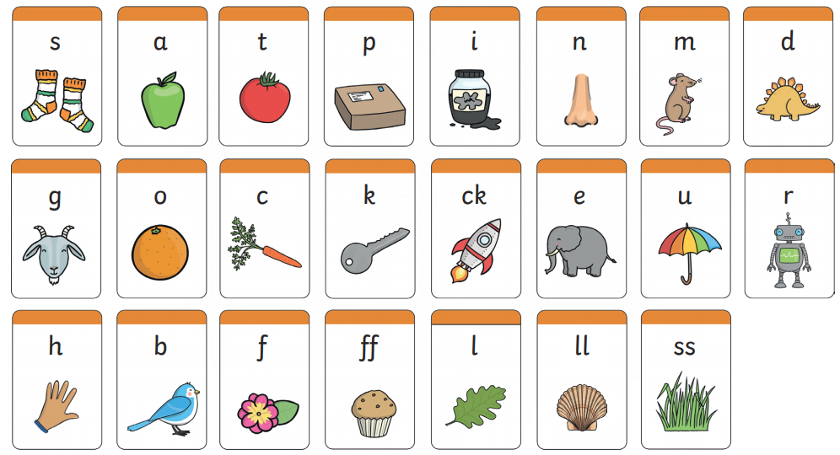
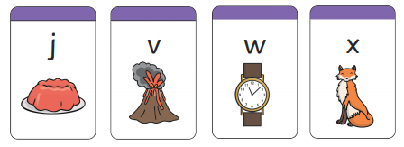
Recap: Can you remember these sounds?

Slide 3
Y y
Can you write a y in the air with your finger. Then practice with a pencil.
Sound talk each word;
y e s yes
y a k yak
y e ll yell
Buried treasure- revise all phase 2
https://www.phonicsplay.co.uk/resources/phase/2/buried-treasure
Can you write each word with your pencil? Hide your screen and segment each word to spell it.

Slide 4
Zz, zz ‘zz’ makes a long z sound.
Write a z in the air with your finger. Can you make
a buzzing sound like a bee?
Sound out the words and match them to the picture.
Challenge- Can you hide the words and use your sounds to
label the pictures yourself?
fizz
zip
buzz
zebra

Slide 5
qu- two letters that make one sound. This is a digraph.
Can you write a q in the air with your finger. Then practice with a pencil.
queen quiz quick

Slide 6
qu- two letters that make one sound. This is a digraph.
Sound spotter- Can you find all of the ‘qu’ sounds below?

Slide 7
Sight words
Sight words break the rules. They can not be sounded out. We just have to learn what they look like.
Rainbow sight words-
Write your sight words using different colours in the shape of a rainbow.
go
no
the
I
so
to
Listen to the wizard’s tricky words song:
https://www.bbc.co.uk/bitesize/topics/zf2yf4j/articles/zdrd8xs

Slide 8
Useful website games:
https://lettersandsounds.org.uk/for-home/reception
https://www.phonicsplay.co.uk/resources/phase/2/pick-a-picture (phonics play, phase 2, pick and picture set 1-5. Username- march20, password- home)
https://www.phonicsbloom.com/uk/game/odd-and-bob?phase=2 (phonics bloom, phase 2, odd and bob, set up to r. Username- march20, password- home)
Alphablocks videos:
https://www.youtube.com/watch?v=VxBEmaaSh1c
https://www.youtube.com/watch?v=WD4-vPkeIqs

