Slide 1
EYFS phonics

Slide 2
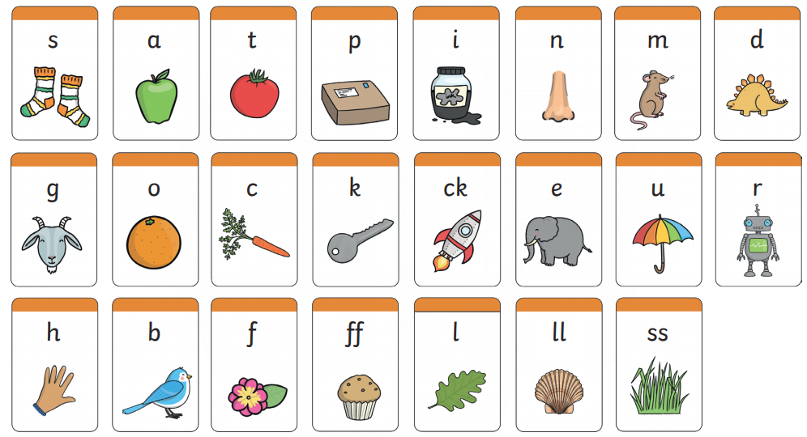
Recap: Can you remember these sounds?

Slide 3
Monday
Sing the alphabet song or watch and sing along here:
https://www.youtube.com/watch?v=75p-N9YKqNo
Remember, these are the names of the letters.
Can you read each sentence below? Have a go and then write your favourite one!

Slide 4
Tuesday
Sound out the words and match them to the picture.
Challenge- Can you hide the words and use your sounds to
label the pictures yourself?
red
pot
bed
hat

Slide 5
Wednesday
Our new sight words are below. Can you write them down?
he she we me
be said there
Go on tricky word trucks and read the sight words.
https://www.phonicsplay.co.uk/resources/phase/2/tricky-word-trucks

Slide 6
Thursday.
Sight word pairs-
Ask your grown up to write 2 sets of our new sight words on cards. Turn two over and if they match then keep the pair.
he
he

Slide 7
Sight words
Sight words break the rules. They can not be sounded out. We just have to learn what they look like.
Rainbow sight words-
Write your sight words using different colours in the shape of a rainbow.
he
me
there
be
she
said
Listen to the wizard’s tricky words song:
https://www.bbc.co.uk/bitesize/topics/zf2yf4j/articles/zdrd8xs

Slide 8
Useful website games:
https://lettersandsounds.org.uk/for-home/reception
https://www.phonicsplay.co.uk/resources/phase/2/pick-a-picture (phonics play, phase 2, pick and picture set 1-5. Username- march20, password- home)
https://www.phonicsbloom.com/uk/game/odd-and-bob?phase=2 (phonics bloom, phase 2, odd and bob, set up to r. Username- march20, password- home)
Alphablocks videos:
https://www.youtube.com/watch?v=VxBEmaaSh1c
https://www.youtube.com/watch?v=WD4-vPkeIqs

