Slide 1
EYFS phonics
Focus sounds: g, o, c, k, ck

Slide 2
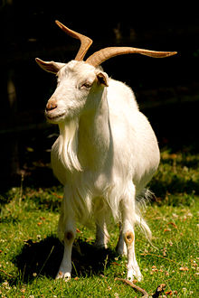
G g – use your finger to write a g in the air, then practise with your pencil.
https://www.youtube.com/watch?v=vz_sRJoz1_w
g, g, g… goat g, g, g… girl g, g, g… gum
Go on a spy walk, what g items can you spot?

Slide 3
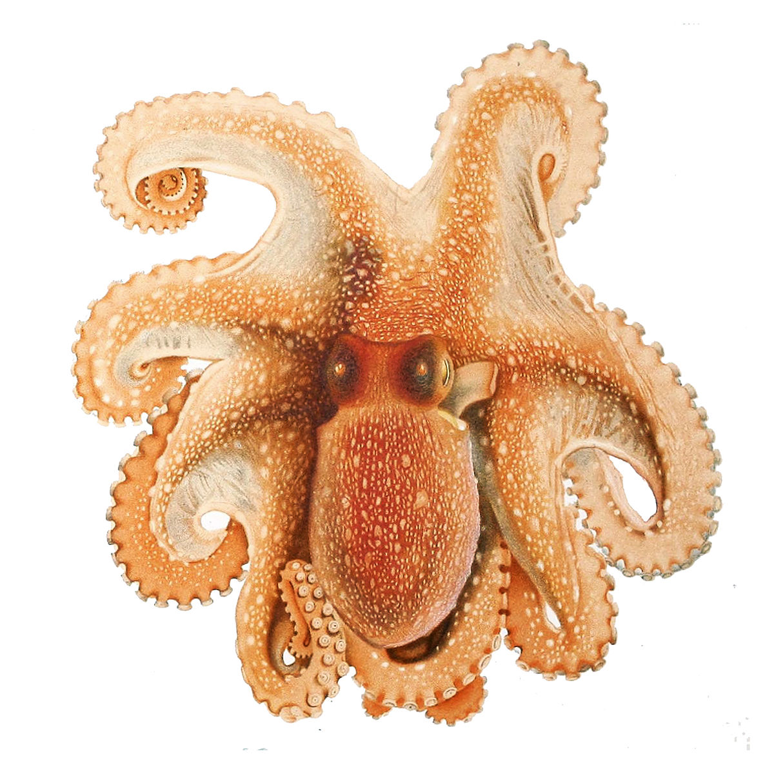
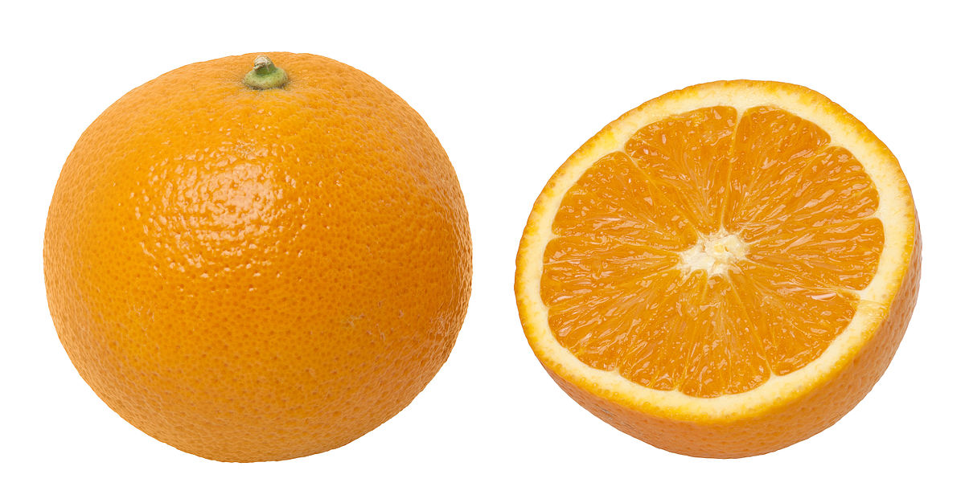
O o – use your finger to write a o in the air, then practise with your pencil.
https://www.youtube.com/watch?v=EwycnpTX6BI
Can you hear the ‘mmm’ at the start of these objects? Name each item together emphasising the ‘mmm’ sound.
p o p pop
n o d nod

Slide 4
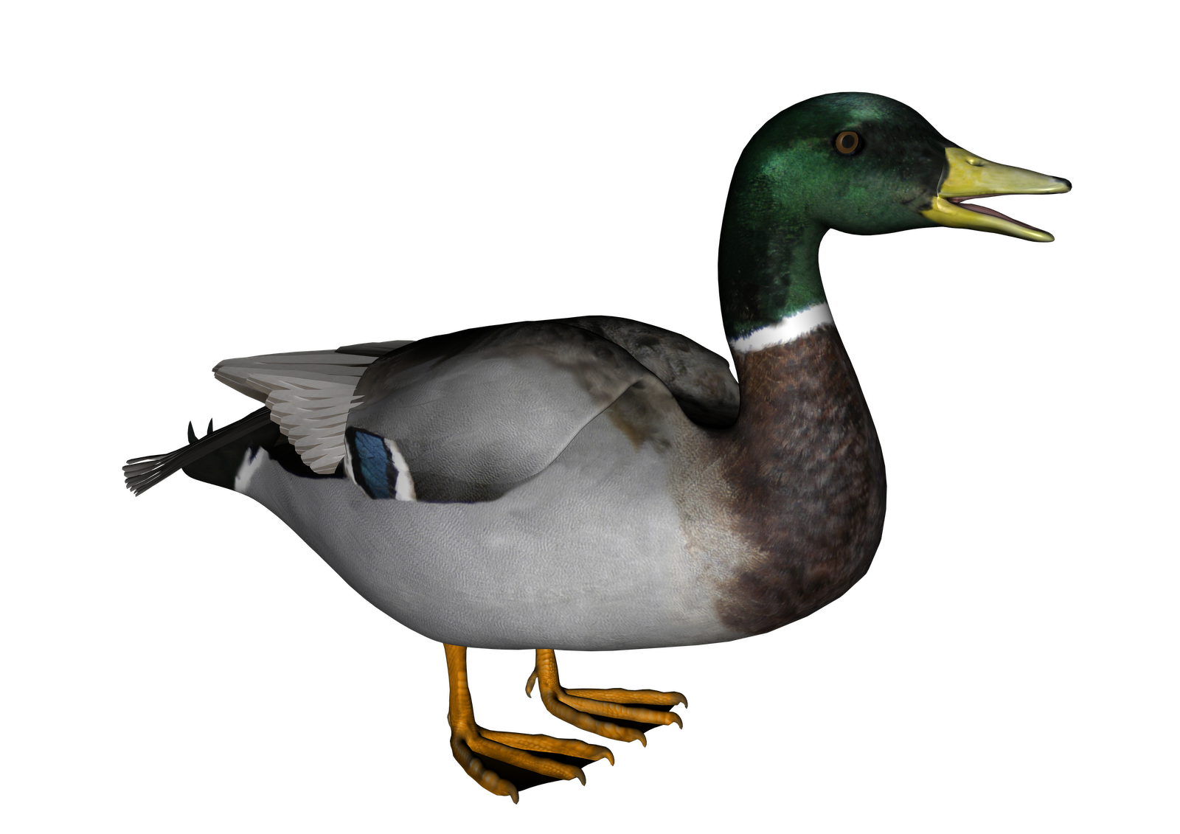
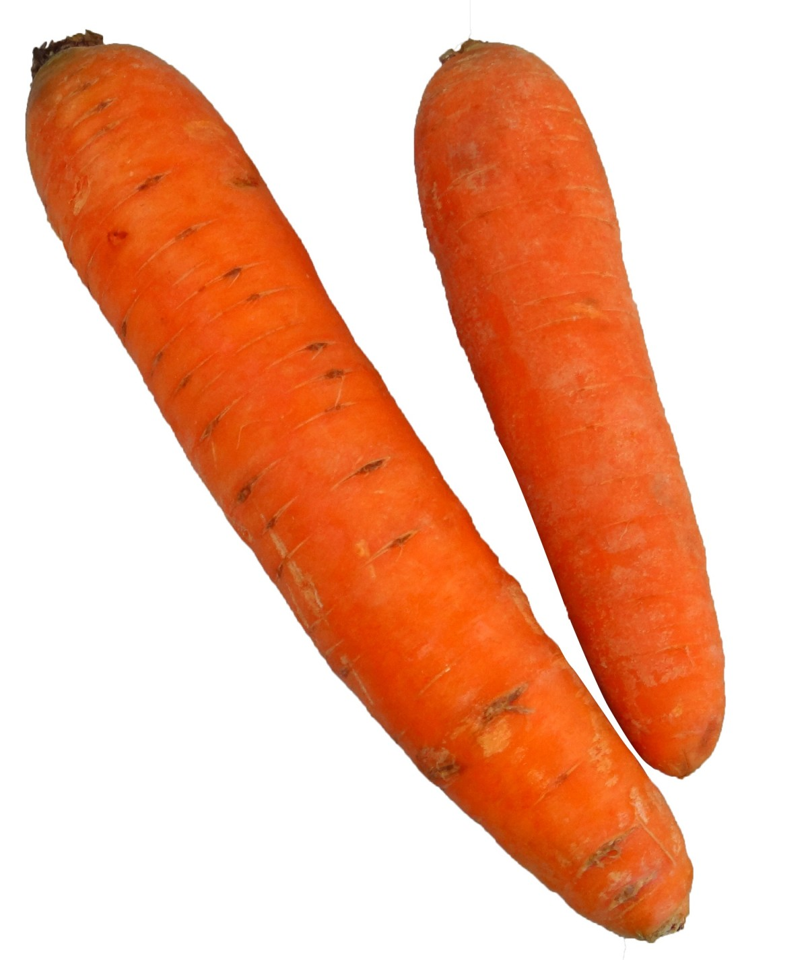
c, k, ck
use your finger to write a ‘c’ and ‘k’ in the air, then practise with your pencil.
Can you hear the c, k, ck sound in these words?

Slide 5
sight words
Sight words break the rules. They can not be sounded out. We just have to learn what they look like.
I
the

Slide 6
Useful website games:
https://www.phonicsplay.co.uk/resources/phase/2/grab-a-giggling-grapheme (phonics play, phase 2, grag a giggling grapheme, g,o,c,k)
https://www.phonicsbloom.com/uk/game/odd-and-bob?phase=2 (phonics bloom, phase 2, odd and bob, set up to c,k)

