Slide 1
EYFS phonics
Focus sounds: ck, e, u, r

Slide 2
ck
use your finger to write a ‘c’ and ‘k’ in the air, then practise with your pencil.
https://www.bbc.co.uk/bitesize/topics/zf2yf4j/articles/z6wxmfr
Can you read these words? Spot the ‘ck’ sound.
s a ck sack
d u ck duck
p i ck pick

Slide 3
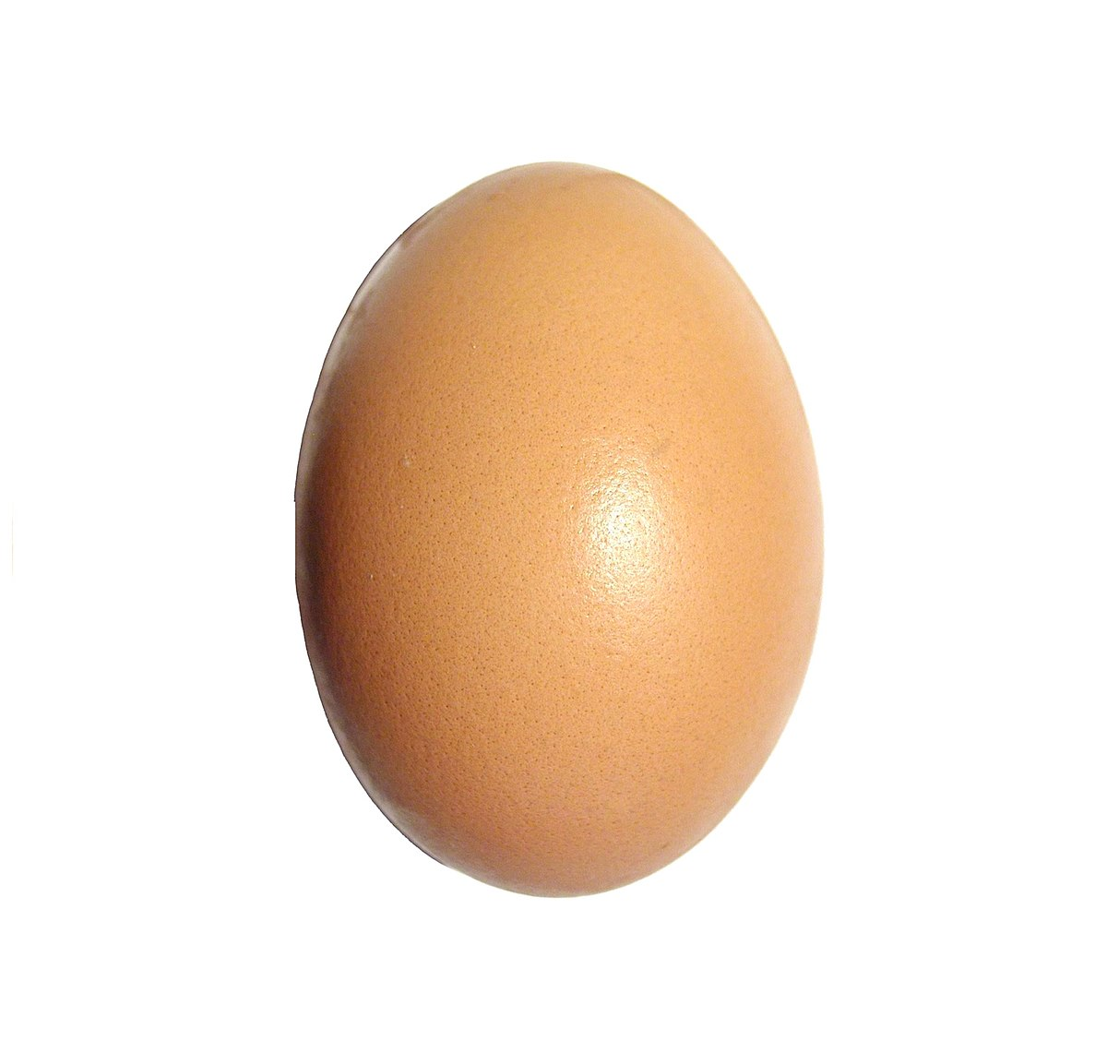
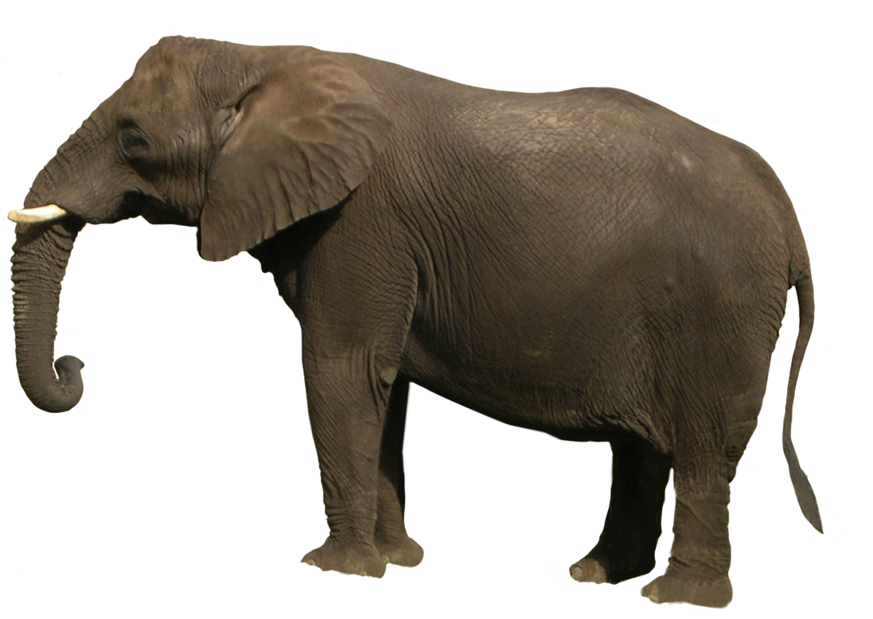
E e – use your finger to write an ‘e’ in the air, then practise with your pencil.
https://www.youtube.com/watch?v=4TmOJh3W90w
e, e, e… egg e, e, e… elephant e, e, e… envelope
Go on a spy walk, what ‘e’ items can you spot?

Slide 4
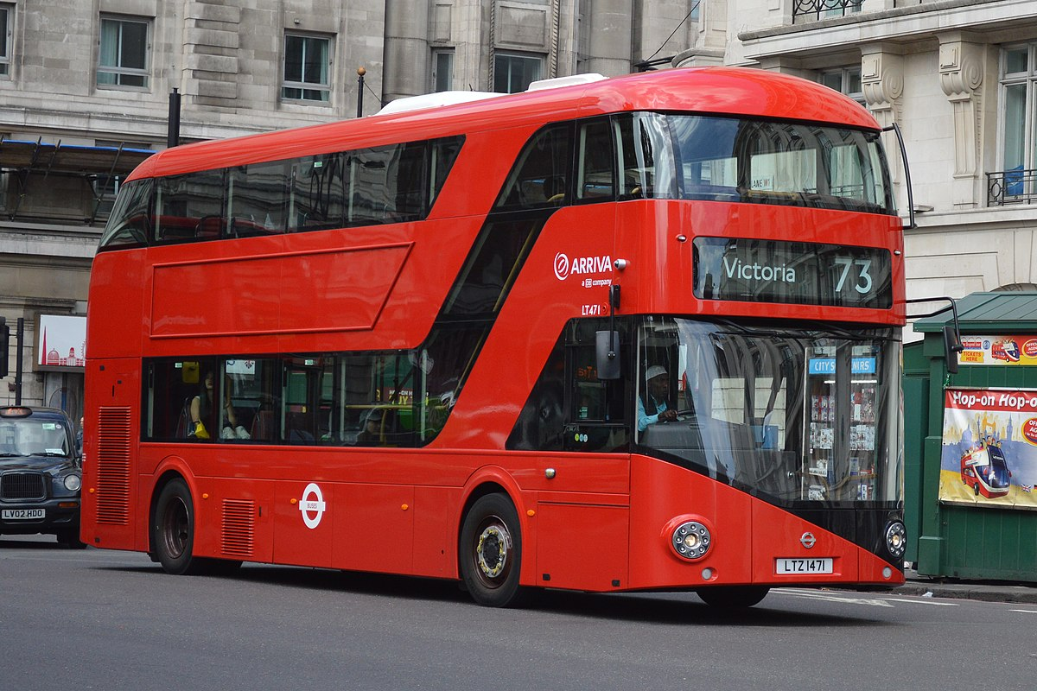
U u – use your finger to write an ‘u’ in the air, then practise with your pencil.
https://www.youtube.com/watch?v=SVVInKjziV4
Can you hear the ‘u’ in these objects? Name each item together emphasising the ‘u’ sound.
s u n sun
d u ck duck

Slide 5
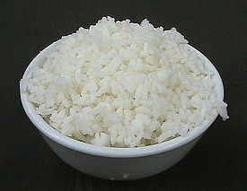
R r – use your finger to write a ‘r’ in the air, then practise with your pencil.
https://www.bbc.co.uk/bitesize/topics/zf2yf4j/articles/zfxsnrd
Can you hear the ‘r’ at the beginning of these objects? Name each item together emphasising the ‘r’ sound.

Slide 6
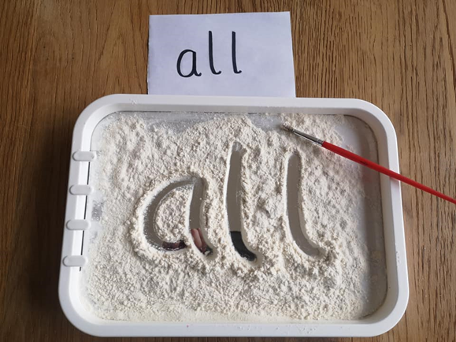
sight words
Sight words break the rules. They can not be sounded out. We just have to learn what they look like.
Can you write sight words I and the in sugar or flour or salt?
I
the

Slide 7
Useful website games:
https://www.phonicsplay.co.uk/resources/phase/2/pick-a-picture (phonics play, phase 2, pick and picture set 1-5)
https://www.phonicsbloom.com/uk/game/odd-and-bob?phase=2 (phonics bloom, phase 2, odd and bob, set up to r)
Alphablocks videos:
https://www.youtube.com/watch?v=VxBEmaaSh1c
https://www.youtube.com/watch?v=WD4-vPkeIqs

