Slide 1
EYFS phonics
Recap all sounds
s a t p i n m d g o c k ck e u r

Slide 2
Alphabet Song

Slide 4
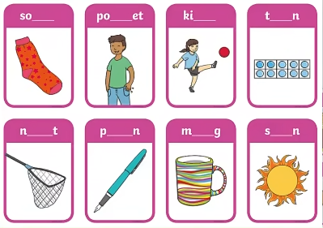

Slide 5
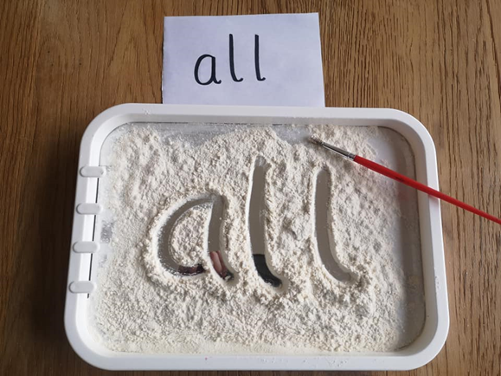
sight words
Sight words break the rules. They can not be sounded out. We just have to learn what they look like.
Can you write sight words I and the in sugar or flour or salt?
I
the

Slide 6
Useful website games:
https://www.phonicsplay.co.uk/resources/phase/2/flashcards-speed-trials (phonics play, phase 2, flashcards speed trial, pick individual graphemes, all up to set 4)
https://www.phonicsplay.co.uk/resources/phase/2/grab-a-giggling-grapheme (phonics play, phase 2, grab a giggling grapheme, +ck e u r)
https://www.phonicsplay.co.uk/resources/phase/2/dragons-den (phonics play, phase 2, dragons den, +r)
Alphablocks videos:
https://www.youtube.com/watch?v=xnOfoSe18Dg

