Slide 1
Friday 15th January
English Lesson

Slide 2
What is an expanded noun phrase?

Slide 3
What is an expanded noun phrase?
A sentence that used one or more adjective to describe the noun.
She had beautiful long curly hair.
A multi-coloured astonishing butterfly flew past.

Slide 4
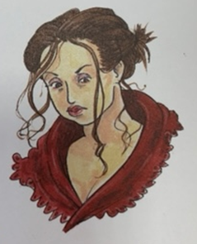
Can you think of an expanded noun phrase for this character?

Slide 5
Can you think of an expanded noun phrase for this character?
The grumpy woman had long dark hair.
She looked like she could shout at your for no reason at all.

Slide 6
How old do you think she is?
What might she do for a job?
What is her personality like?

Slide 7
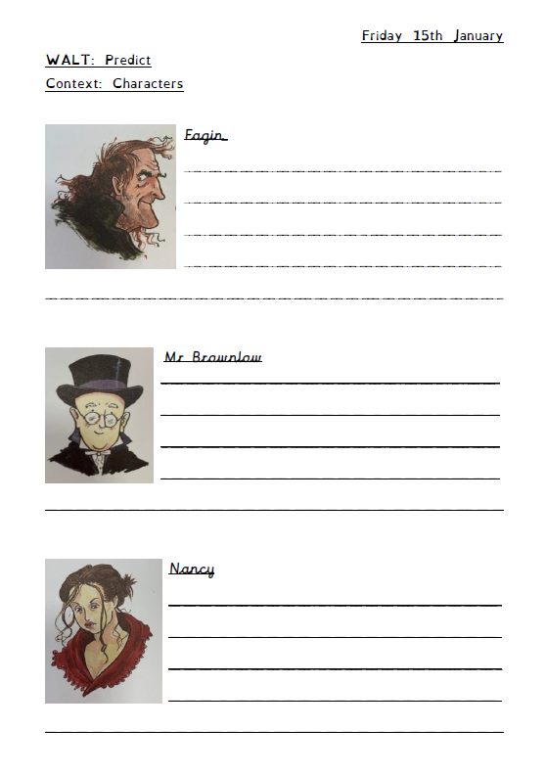
Task
Predict what you think these characters might be like in the book.
To extend your sentences use the power of because.
I think Mr Brownlow is a kind gentleman. He works in an old tall bank all day long. When he finishes work he walks home and feeds hungry dogs.

Slide 8
English Drop-in
Don’t forget, if you have any questions please feel free to contact Miss Ware on teams.

