Slide 3
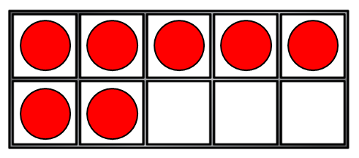
1) How do you spell the number 9?
2) What is one more than 9?
3) How many counters?
4) Which is the 5th flower?

Slide 4
1) How do you spell the number 9?
2) What is one more than 9?
3) How many counters?
4) Which is the 5th flower?
nine
10
7

Slide 6
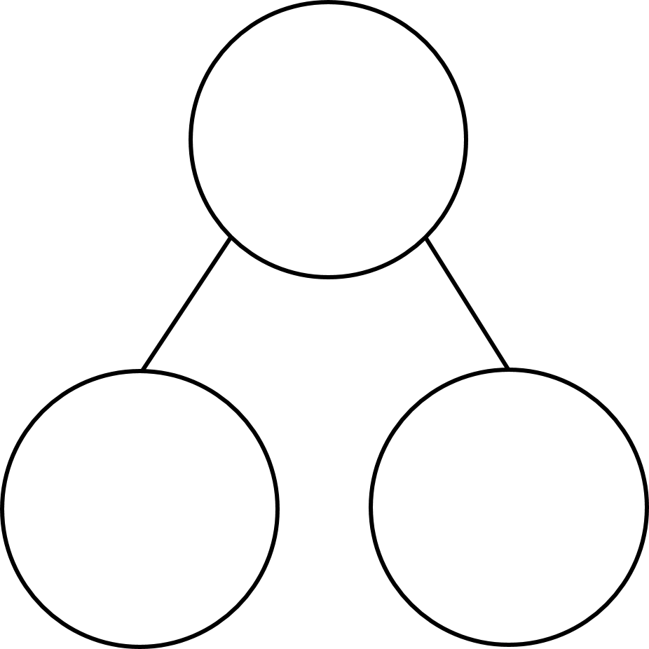
Part-Whole model
Whole
Are the parts always at the bottom?
Part
Part

Slide 7
Have a think
Whole
Part
Whole
Part
Part
Part
Which is NOT correct?

Slide 9
I can count on from 5!
5

Slide 10
Have a think
1
7
6

Slide 11
How many different ways could we complete the part-whole model?
1
5
4

Slide 12
How many different ways could we complete the part-whole model?
2
1
5
3
4

Slide 13
How many different ways could we complete the part-whole model?
5
2
1
5
0
3
4

