Slide 1
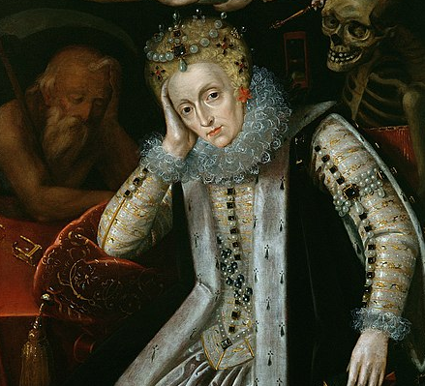
How did the Tudor Age come to an end?

Slide 2
The Tudor Age came to an end when Elizabeth 1 died childless in 1603.
The Tudor Age began in 1485 and lasted for 118 years.
Can you remember the names of the Tudor monarchs.
Think, pair, share

Slide 3
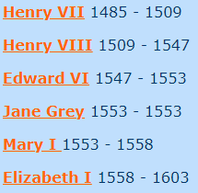
Here’s a list of the Tudor monarchs and the length of their reigns.
Can you work out how long Elizabeth 1 reigned for?

Slide 4
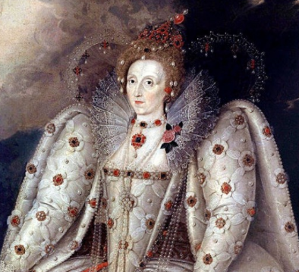
Elizabeth 1 reigned for 45 years.
That’s a long time!
Elizabeth’s reign is considered one of the most glorious in English history.
Under her rule, England advanced in such areas as foreign trade, exploration, literature, and the arts.

Slide 5
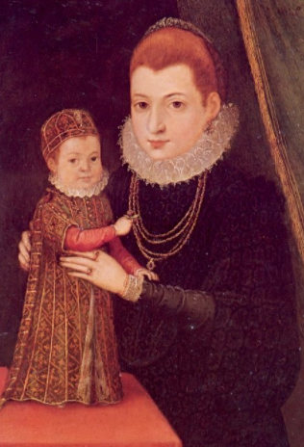
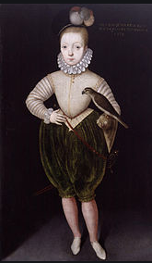
But who ruled England after Elizabeth’s death in 1603?
Let’s find out.
Do you remember Mary Queen of Scots?
She had a little boy called James. He was already King James VI of Scotland when his cousin, Elizabeth I, died and he became King James I of England as well.
A painting of James when he was a boy.
James as a baby with his mother, Mary Queen of Scots.

Slide 6
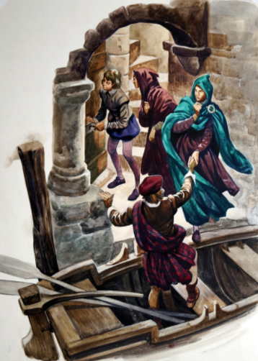
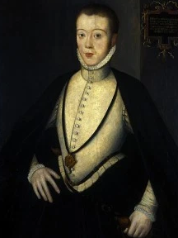
James had become King of Scotland at only 13 months old when his father had been murdered and his mother, Mary Queen of Scots, was forced to abdicate and flee to exile in England.
Image of Mary fleeing from Scotland.
Image of Henry, Lord Darnley, who was the father of James.

Slide 7
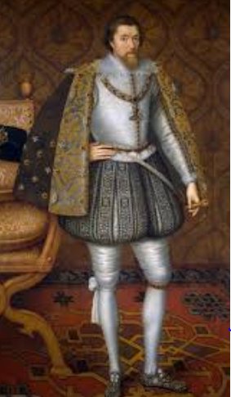
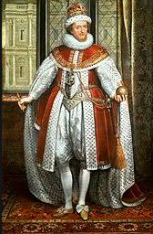
James was a very educated man - a poet and scientist - but he was not a good king. He relied on his favourites, who were rewarded lavishly, and argued with his Parliament.
He was described at the time as the "wisest fool in Christendom".
What do you think this phrase means?

Slide 8
Use the websites below to find out some facts about James 1.
Use these to create a fact file about James 1.
Include some of the following:
His childhood
Being King of Scotland
Marriage and children
King of England
Death
https://kids.britannica.com/kids/article/James-I/476283
https://kids.kiddle.co/James_I_of_England
https://schoolhistory.co.uk/notes/james-i/
http://encyclopedia.kids.net.au/page/ja/James_I_of_England

Slide 9
Plenary
Share two facts that you have discovered about James 1 of England and V1 of Scotland.

