Slide 1
Vocal Chords
What are vocal chords?
How are they linked with sound and pitch?

Slide 2
4 corners – Where are your vocal chords?
In your mouth In your throat
In your stomach In your chest

Slide 3
Larynx
Take a deep breath in. You just filled your lungs with air. As you breathe out, that air travels back up your windpipe, also called the trachea, the tube-like passageway in your throat for air.
The box-shaped area at the top of your windpipe is called the larynx. The larynx is nicknamed the voice box because it holds the body parts that help us speak. So you could say that the larynx is the source of your voice. Have you ever noticed the small bump on the front part of your throat below your chin? That is your larynx.

Slide 4
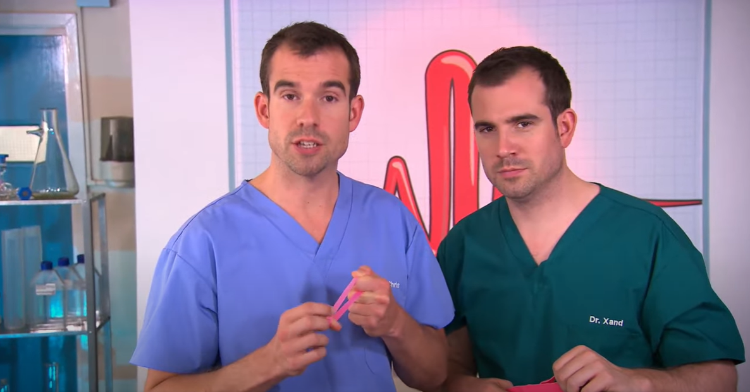
Let’s learn from the professionals…
https://www.youtube.com/watch?v=GDzcLZDdxqs

Slide 5
Let’s test our knowledge…

Slide 6
What do we now know…?
The ________ your vocal chords vibrate the higher the pitch.
When you whisper your vocal chords _________ vibrate.
When you create a low pitch sound, the vocal chords relax and vibrate ____________.

Slide 7
What do we now know…?
The faster your vocal chords vibrate the higher the pitch.
When you whisper your vocal chords don’t vibrate.
When you create a low pitch sound, the vocal chords relax and vibrate slower.

Slide 8
How did we work today?

