Slide 1
Who was the greatest explorer?
In this project we will be finding out about European explorers from the 15th, 16th and early 17th centuries.

Slide 2
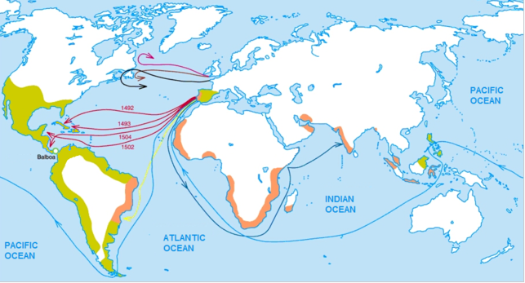
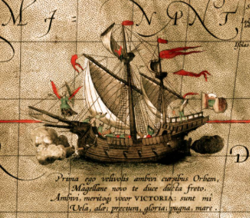
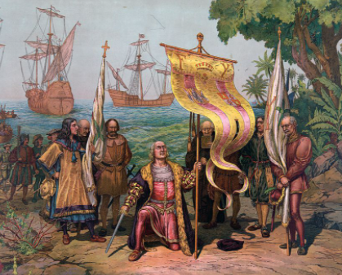
We will be focussing on European explorers from what is often called the Age of Exploration.
This began in the early 15th century continuing until the early 17th century.

Slide 3
To put that into context it spans almost the same time period as the War of the Roses through to the reign of James 1.
In this project we won’t just be looking at English explorers but also explorers from other countries in Europe.

Slide 4
What do you know about explorers?
Here are some ideas to help you
What is an explorer?
Why do people want to explore?
Do I know of any explorers?
Do I know of any explorers from the Age of Discovery?

Slide 5
What do I want to find out during this project?
This is your opportunity to think of some questions that you would like to find the answers to.
Here are some ideas to help you
Think about
Why did so many Europeans go off exploring in the 15th and 16th centuries?
What were they hoping to find?
What was it like being an explorer?
What happened to the places they found?

Slide 6
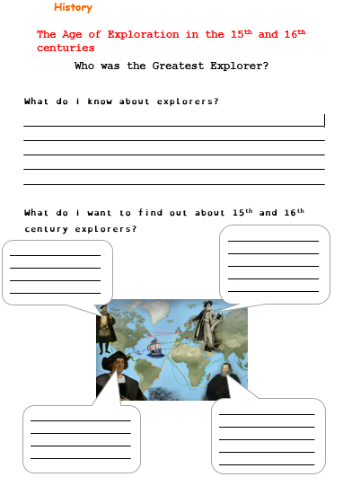
Now complete this sheet or record your ideas in your red book.

Slide 7
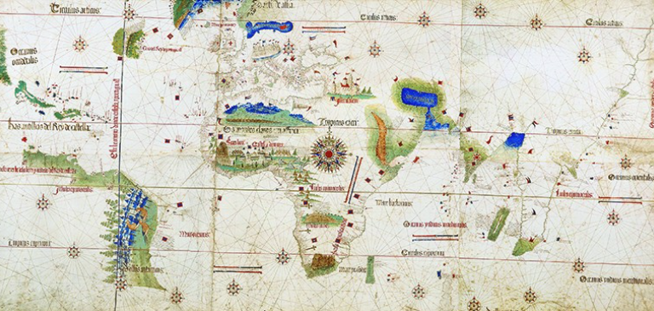
This is a map of the world from 1502.
It is called the Cantino Map.
Now compare it with a modern map,(see the next slide)
What do you notice?

Slide 8
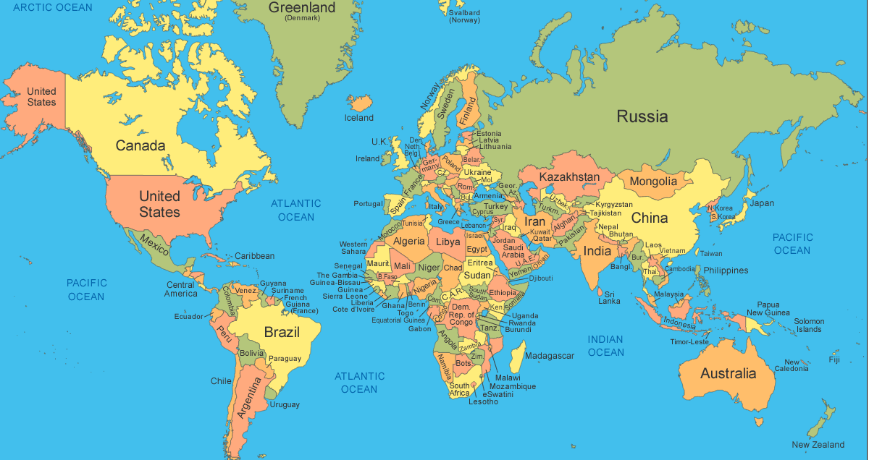
Record your ideas on the sheet or in your red book.

Slide 9
The same | Different
Great Britain is shown on both maps. The continent of Africa is shown and is depicted quite accurately on the Cantino Map. India is shown. | Australia and New Zealand are not shown on the map. Only a small part of America is depicted on the Cantino Map. This is actually the coast line of Brazil.

Slide 10
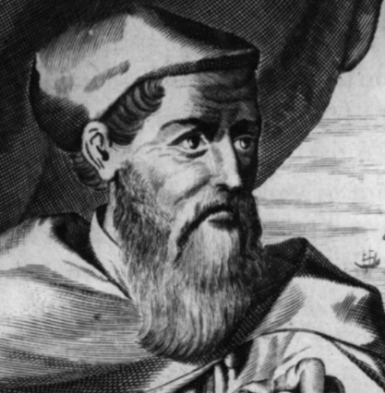
Now for some trivia
This is a picture of Amerigo Vespucci.
Can you guess which country is named after him?

