Slide 1
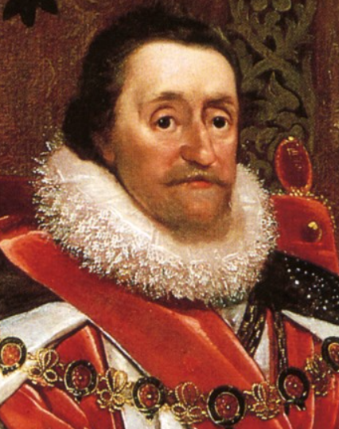
James I
What was his childhood like?
________________________________________________________________________________________________________________________
Marriage and children
________________________________________________________________________________________________________________________
Being King of Scotland
________________________________________________________________________________________________________________________
Being King of England
__________________________________________________________________________________________________________________________________________________________________________________________
Did you know?
______________________________________________________________________________________________________________________________________________________________________________________________________________________________________________________

