Slide 1
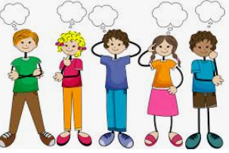
Lesson 5
WALT-edit and improve a story.
What is editing?
Editing is when we fix the mistakes in our writing.
It can be correcting spelling mistakes, punctuation and grammar.

Slide 2
Can you edit this paragraph.
Look for the spelling, grammar and punctuation mistakes.
Quickly, May whent into the garden She look around. the flour beds were overgrown wif weeds and the grass waz in need of mowing. She stoped by a old oak tree to catch her breath.

Slide 3
How many mistakes did you find?
Quickly, May whent into the garden She look around. the flour beds were overgrown wif weeds and the grass waz in need of mowing. She stoped by a old oak tree to catch her breath.
Full stop needed.
Quickly, May went into the garden. She looked around. The flower beds were overgrown with weeds and the grass was in need of mowing. She stopped by an old oak tree to catch her breath.

Slide 4
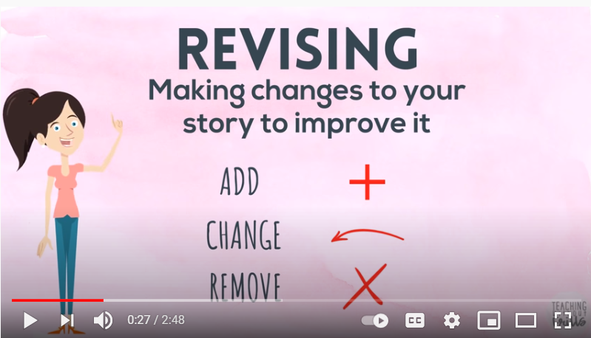
Improving your story.
https://www.youtube.com/watch?v=1T6PmQQlKss

Slide 5
Look at these sentences. Chooses one to improve.
May walked into the garden.
She looked around.
She stopped by an old oak tree to catch her breath.
You can add fronted adverbials, non- finite verbs, a subordinating conjunction, more powerful verbs or interesting adjectives.

Slide 6
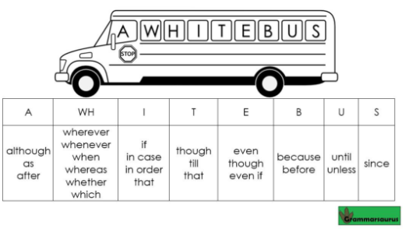
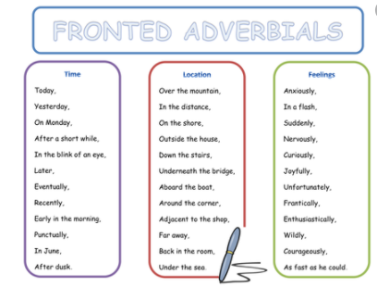
Subordinating Conjunctions
Use these to help you improve your writing.

Slide 7
Quietly, May walked into the ornate garden.
As she looked around, she noticed that the grass needed mowing .
She rested by an ancient oak tree to catch her breath.

Slide 8
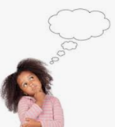
Now reread your story.
Choose a paragraph to improve.
Does it make sense?
Do you notice any spelling, punctuation or grammar mistakes?
Could you improve some of the sentences?

Slide 9
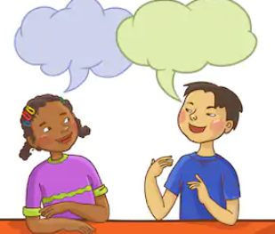
Plenary
Read your edited and improved paragraph.
Have you made it even better?

