Slide 1
Monday 18th January
Home Learning
Non-Chronological Reports

Slide 2
WALT: retrieve and record information from a text

Slide 3
Let’s look at an example of a non-chronological report…

Slide 4
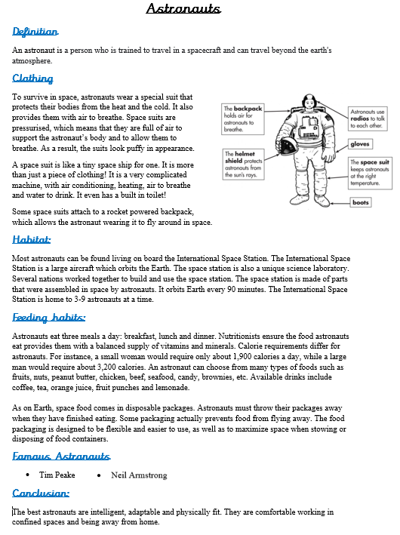

Slide 5
Language Questions:
What adjective does the text use to describe the appearance of the space suit?
What does unique mean?
What do you think a nutritionist is?
Inference Question:
1) Why do you think an astronaut needs to be good in confined spaces?
Direct Questions:
How many meals a day does an astronaut eat?
What are the 3 main characteristics that ‘the best’ astronauts are said to have?
What does the rocket powered backpack allow the astronaut to do?
What is the purpose of the helmet shield?

Slide 6
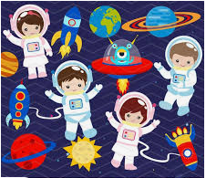
Plenary…
Would you like to be an astronaut?
Justify your answer.

