Slide 1
Monday 11th January
English – Reading Skills

Slide 2
Why do we read?

Slide 3
Reading for pleasure
Reading buddies
Quiet reading
Class books
Reading for meaning
Whole class reading
Guided reading
Discussing vocabulary

Slide 4
Reading Skills

Slide 5
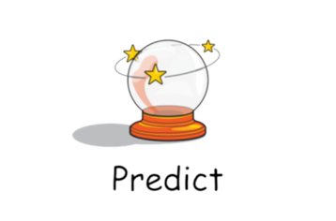
Today we are learning to …
What is predicting?

Slide 6
Today we are learning to …
What is predicting?
Predicting is when we use our knowledge to think what might happen next.

Slide 7
Let’s look at the front cover
What can you see? (the literal)
What do you already know about the things you can see?(prior knowledge)

Slide 8
Let’s look at the front cover
We can use these answers to help us make a sensible prediction on what the story is about.
What do you predict will happen in the story?

Slide 9
Task

Slide 10
What questions do you have about this book?

Slide 11
English Drop-in
Don’t forget, if you have any questions please feel free to contact Miss Ware on teams.

