Slide 1
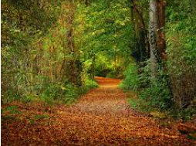
Lesson 2
SPaG starter
thick
dense
impenetrable
Think, pair, share
How many adjectives can you think of to describe the wood?
You have one minute.
crackle
crunchy
emerald
What could these words best describe in the wood?
twisting
meandering

Slide 2
Listen carefully to the rest of the story.
At that moment he heard something coming towards him; well- something or somebody- blundering through the trees. Desperately, Tim grabbed Barney’s collar and squatted down behind a bush. What happened next amazed him, for a small boy, about his own age, ran into the clearing, paused and then began to scramble up a tree. What was strange was that it was dressed in a rough tunic. He looked like something out of his Roman history books.
A moment later, there was a shriek and a thud as the boy landed on his back! He lay there, curled up for a while and then he was up again and off in another direction, running low. Tim could hear what sounded just like a pig snorting about in the opposite direction.
Pigs in the forest? Tim smiled to himself. He must be hearing things. He whistled for Barney, put the tile in his pocket and set off for his grandparents’ house. It was then that he noticed there was silence. Tim shook his head and grinned. Pigs in the forest- more like bats in the belfry. It was time to go home.

Slide 3
Lesson 2
WALT- create a story map.
Let’s recite paragraph one of the story.
Tim ran through the forest calling and calling. Where had Barney gone to now? That dog was always chasing rabbits and never came when he was called. Tim paused by a large oak tree to catch his breath. He felt cross with his grandparents. They always made him take the dog for a walk whenever he visited. He would rather have been sat in front of the television. There were always good films on New Year’s Eve. A distant bark brought him back to the present and he dashed on.

Slide 4
Barney was digging furiously amongst the old bracken and damp leaves. Tim pulled him back and the dog sat watching him, panting – with his tongue hanging out like a strip of bacon. There in the soil was an orange rock. At least, that was what Tim thought at first. But as he tugged it out and brushed off the soil, he realised that he was holding a large orange tile.
Tim shivered. He was certain that it was a Roman tile. He had seen pictures of these in his history book at school. Carefully, he turned it over. He was thrilled with the discovery and was just about to give Barney a well deserved pat when he noticed something about the tile. There was a paw-print on the surface. It was too small for a dog like Barney’s. Tim rubbed off the soil and wondered if it was a cat’s.
Now let’s learn the next two paragraphs

Slide 5
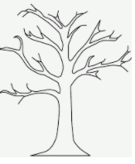
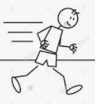
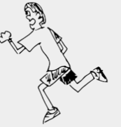
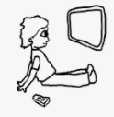
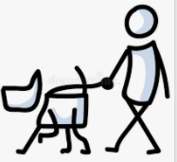
Draw a story map showing what happens in these paragraphs.
Here’s an example of the first paragraph.
Tim
Tim paused by an old oak tree.
A distant bark…

Slide 6
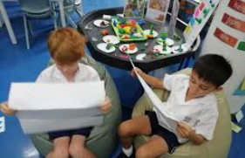
Plenary
Using your story map take it in turns to retell the story to your talk partner.

