Slide 3
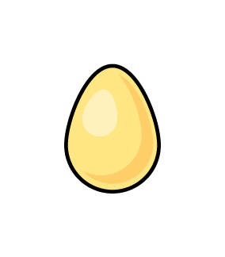
1) Here are 3 _______
2) Compare. What symbol is missing?
3) What shape is the cylinder?
4) Which one doesn’t belong?

Slide 4
cones
1) Here are 3 _______
2) Compare. What symbol is missing?
3) What shape is the cylinder?
4) Which one doesn’t belong?
=

Slide 6
Sorting rules:
What is the same?
What is different?

Slide 7
Sorting rules - shape
Cone Cylinder Cube

Slide 8
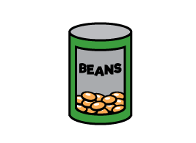
Sorting by shape
Have a think
Cone Cylinder Cube

Slide 9
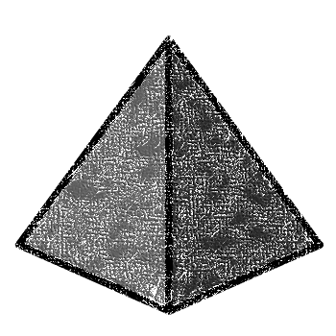
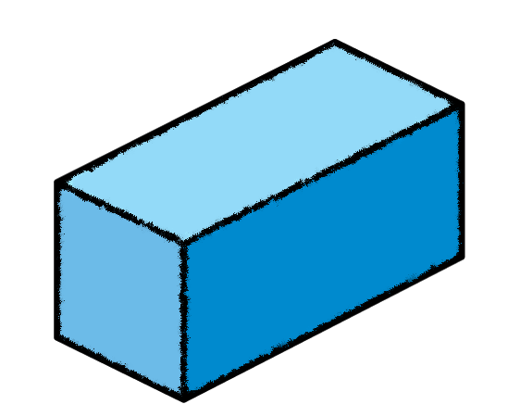
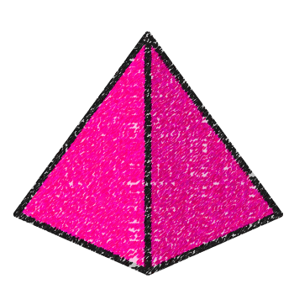
Sorting rules - shape
Sphere Pyramid Cuboid

Slide 10
Sorting by shape
Have a think
Sphere Pyramid Cuboid

Slide 11
Sorting by colour
Have a think
Which ones are not sorted correctly?
The brown and the blue
cylinder
cone

Slide 12
Sorting rules - stacks

Slide 13
Sorting rules - rolls
Have a think

