Slide 1
Spellings
Tuesday 26th and Thursday 28th January
Strategies for learning spellings and apostrophes for possession.

Slide 2
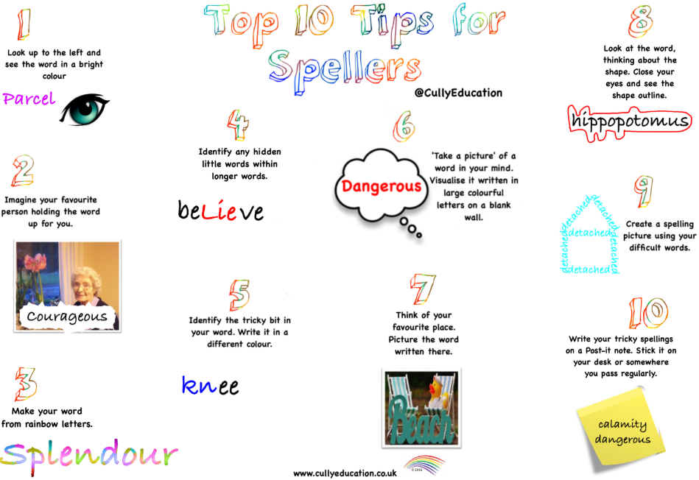

Slide 3
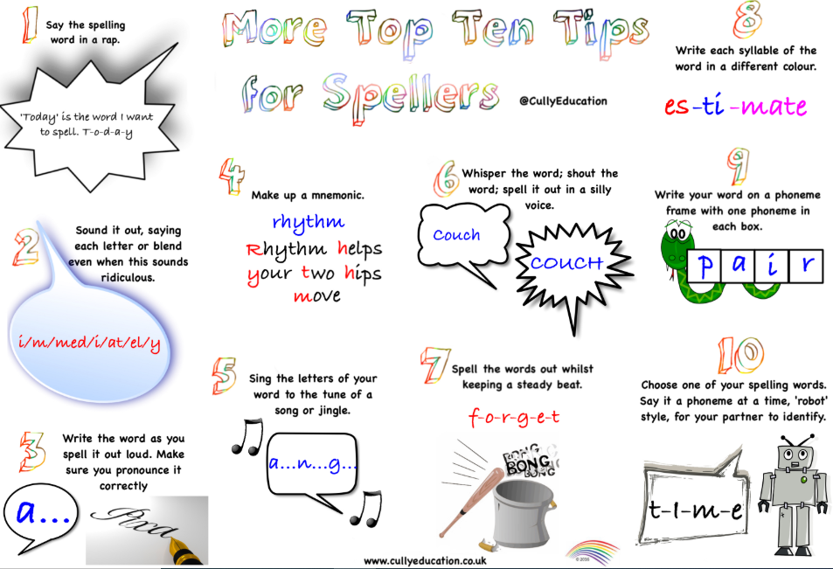

Slide 5
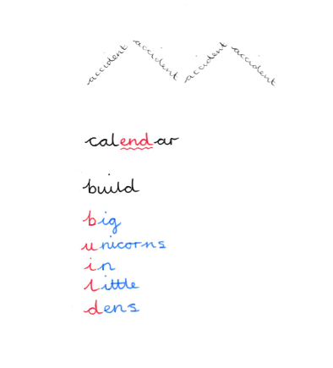
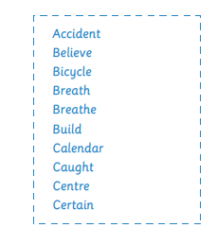

Slide 6
Now we are going to look at apostrophes for possession.
First of all can you draw an apostrophe?
What do we mean by the word possession?
Where does the apostrophe go?

Slide 7
Now we are going to look at apostrophes for possession.
First of all can you draw an apostrophe?
What do we mean by the word possession?
Where does the apostrophe go?
Possession is something that is owned.

Slide 8
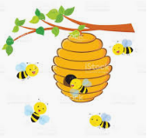
Be careful with apostrophes
Singular possessive
Plural possessives
The bee’s hive
The hive belongs to one bee.
The bees’ hive
The hive belongs lots of bees.

Slide 9
Look carefully at these two sentences.
1.The kitten’s basket was in the kitchen.
2.The kittens’ basket was in the kitchen.
Draw a picture to show the difference.

Slide 10
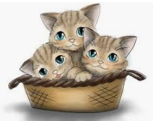
1.The kitten’s basket was in the kitchen.
2.The kittens’ basket was in the kitchen.

Slide 11
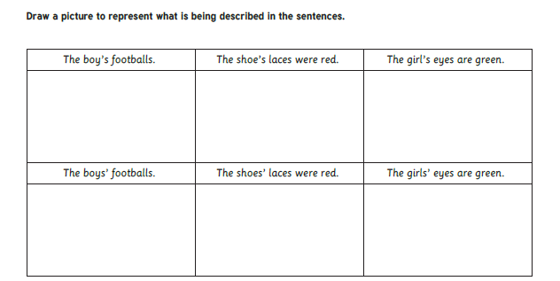

Slide 13
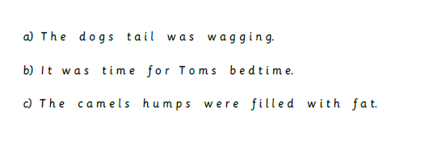
Place the apostrophes in the correct place.

Slide 14
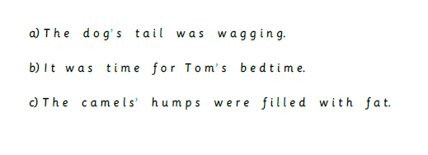

Slide 15
You can let me know how you got on by emailing
year3and4@uphillprimary.co.uk

