Slide 1
Dear Young Musicians & your Parents,
I was REALLY looking forward to continuing music with you this term, but unfortunately we cannot…
I am going to send through a Music lesson for you to take part in and enjoy every week. I understand that you might not have instruments at home…I have designed the activities so that they can be done with clapping and singing (or a ruler and a pencil!). If you do have an instrument at home, please feel free to do the activities using them too.
Parents – I have included an audio clip with each activity to help you, to help your musician. If the YouTube links do not work from within the Powerpoint, they should work if you copy and paste them to your internet browser.
Have a lovely time making music together!
Stay safe, Miss Dixon

Slide 2
Music in a Wider Context
Have a think….see how many places you can think of where you hear music?
(NOT including at home, in the car, at school, or on the TV…!)

Slide 3
A couple of examples to enjoy….
(both clips are pre-covid)
Bristol Street Pianos at The Mall, Cribbs Causeway!! The pianos were all around the city and were just there for people to enjoy and play!
https://www.youtube.com/watch?v=dG3crr7-gOw
In a train station!! Just going about your daily travels and this happens….!
https://www.youtube.com/watch?v=ifKnqMekWx8

Slide 4
Tempo
You will understand: what Tempo means
You should understand: how Tempo can affect a piece of music
You might understand: how to start using Tempo to help your piece!

Slide 5
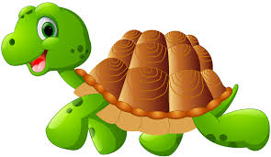
Tempo
What is Tempo?
Have a think…perhaps you can describe or demonstrate what tempo is…if you’re not sure, check in with Mum or Dad…do they know?
Discuss what you think it is, together.
These pictures are a clue…
A cheetah runs….?
A tortoise walks…?

Slide 6
Tempo is the speed of the music! Well done if you got it right!
Have a go at clapping these…at a SLOW tempo…clap along with the tracks below
No clapping
With clapping!
Now try clapping these…at a FAST tempo…clap along with the tracks below
No clapping
With clapping!

Slide 7
Have a go at clapping these…clap along with the tracks below
The Tempo is going to change during the piece….be ready!!!
QUAVERS
=1/2 beat each (One pair = 1 beat)
No clapping
With clapping!
Doo be

Slide 8
Tempo
Watch this clip…
https://www.youtube.com/watch?v=YIbYCOiETx0
As you listen…
1st time – what does it make you want to do? Why?
2nd time – jot down as many as instruments as you can remember the names of, from the The Big Four (Strings, Brass, Woodwind, Percussion families)
3rd time – what animal would you associate this piece of music with? (Mum or Dad might be able to help with this one!)

Slide 9
Tempo
So, we may not have our boomwhackers at the moment but we have our voices….!! Have a go at singing along with this! (Don’t try and be ALL the colours at once…!)
https://www.youtube.com/watch?v=PvxonG28IA4

Slide 10
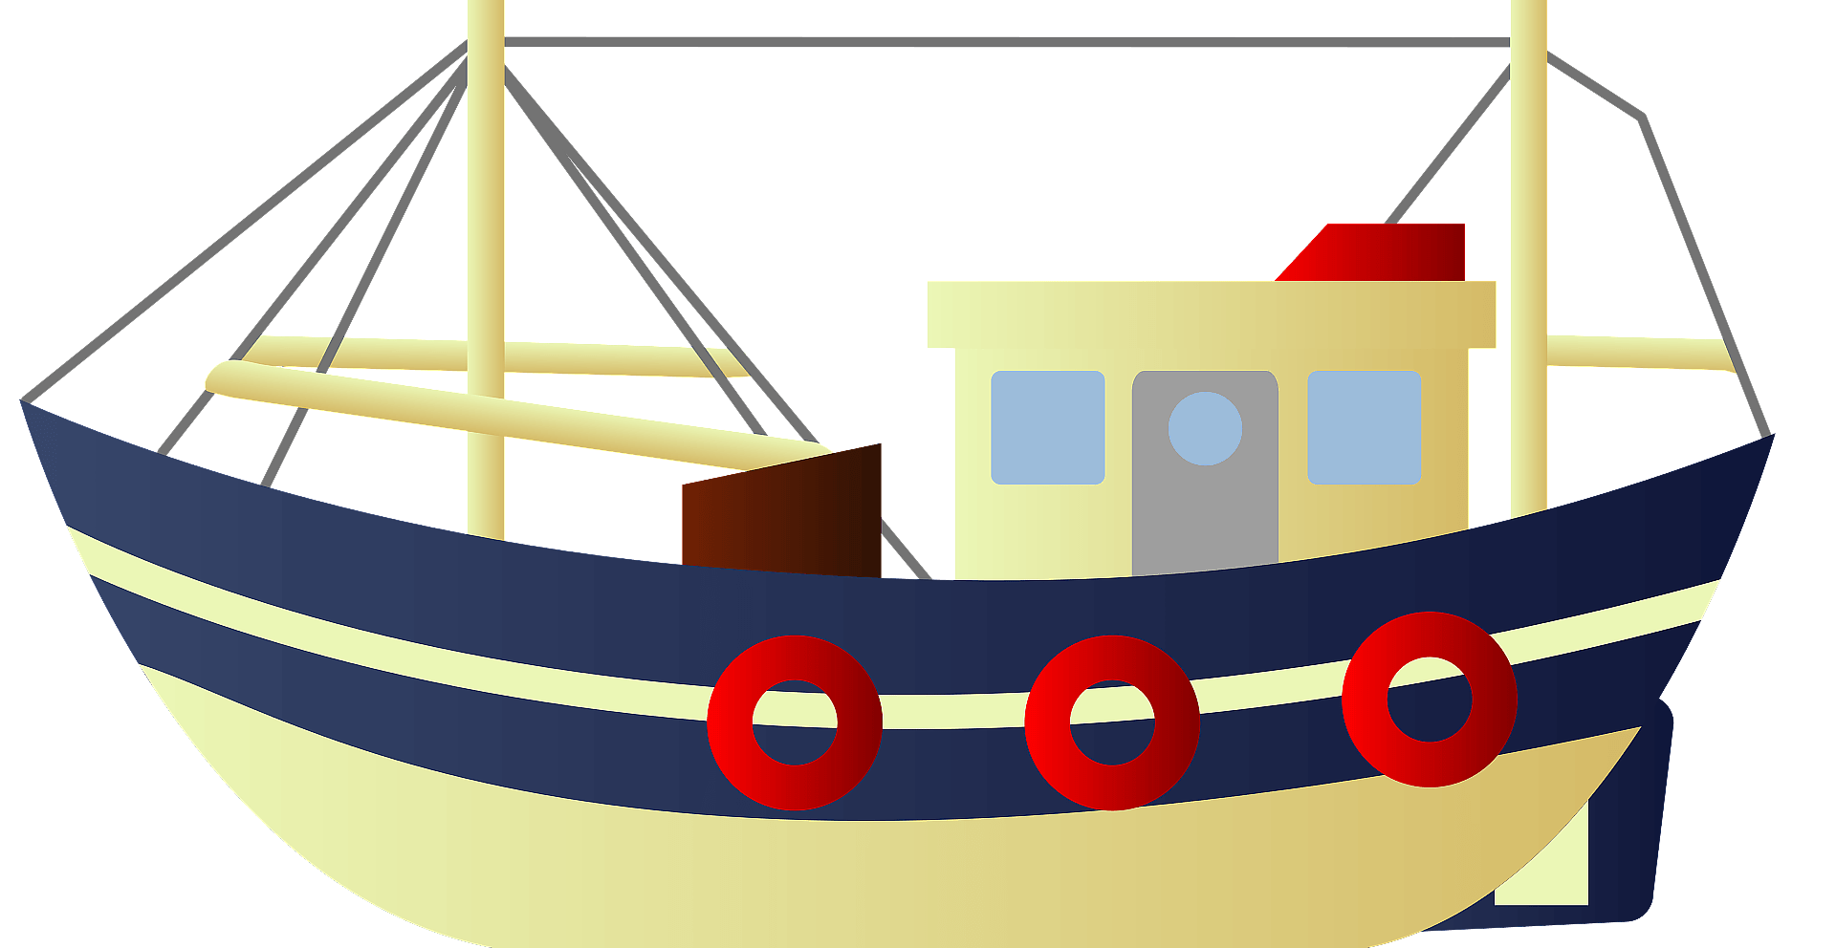
Tempo
All of this talk about Tempo is linking us round to your class project for this term…! I understand that it is all about the oceans, seas and voyages?!
So…final task for this week…design a Music boat! It does not have to be too complicated…a picture with some music designs on it is a good start!
We are going to be composing (writing) some music for our voyage over the next few weeks!
Good luck shipmates!!

