Slide 1
Wednesday 13th January
English Lesson

Slide 2
What is a noun?
What is a proper noun?
What does a proper noun start with?

Slide 3
What is a noun?
A person, place or thing.
What is a proper noun?
A name of a particular person, place or thing. For example London, Miss Ware.
Uphill is a proper noun because we are talking about a specific place. However school is a noun because we are not referring to a specific school.
What does a proper noun start with?
A capital letter.

Slide 4
https://www.bbc.co.uk/bitesize/topics/zrqqtfr/articles/zpd8ng8#:~:text=Proper%20nouns,begin%20with%20a%20capital%20letter.

Slide 5
Oliver Twist
This term we are going to be reading the book Oliver Twist by the author Charles Dickens.
Have you ever heard of this book before?
Have you read it?

Slide 6
Oliver Twist
We will be using our imaginations to complete our learning this week. We will start reading the book together next week.

Slide 7
We are going to look at illustrations of characters from the book we are going to read.
Think about;
- Are they rich or poor?
- Do they live in the past or present?
- Are their clothes smart or scruffy?
- Do they look happy, sad, scared?

Slide 8
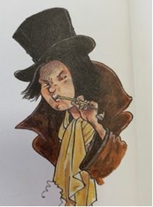
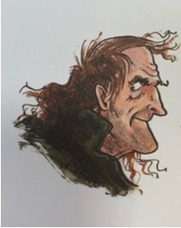
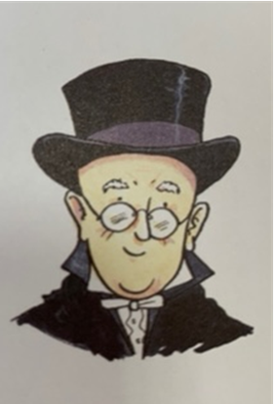
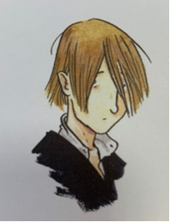
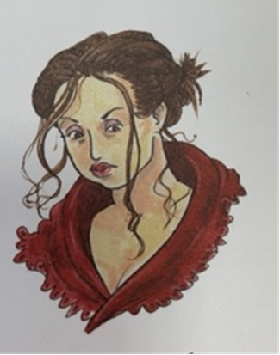

Slide 9
- Are they rich or poor?
- Do they live in the past or present?
Are their clothes smart or scruffy?
- Do they look happy, sad, scared?

Slide 10
On the sheet of paper or in your home learning books now write down adjectives to describe these people.
To extend your work can you use sentences and use the power of because?
He looks dirty and smelly because he has black soot on his face so he might be working up chimneys.

Slide 11
English Drop-in
Don’t forget, if you have any questions please feel free to contact Miss Ware on teams.

