Slide 1
Year 1 Phonics
Focus sounds:
au ey

Slide 2
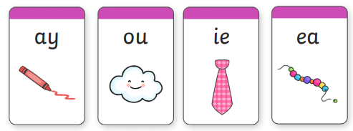
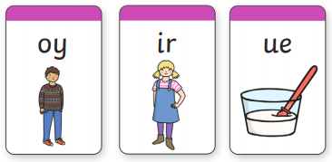
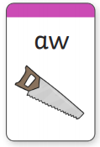
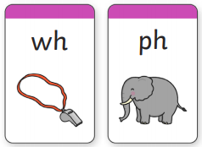
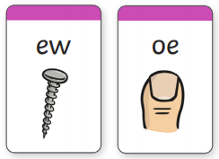
Can you still…
Sound out each of these:

Slide 3
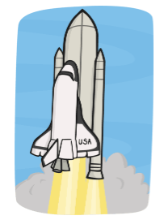
au- two letters that make one sound. This is a digraph.
The au sound makes the same sound as ‘or’ and ‘aw’.
Say out loud what you see in each picture, sound talk each word and write it down, underlining the au digraph.

Slide 4
au- two letters that make one sound. This is a digraph.
haunt august launch sauce
Hide your screen and see you if you can write each word segmenting the sounds you hear.
Challenge: Can you write a sentence using the sound au?

Slide 5
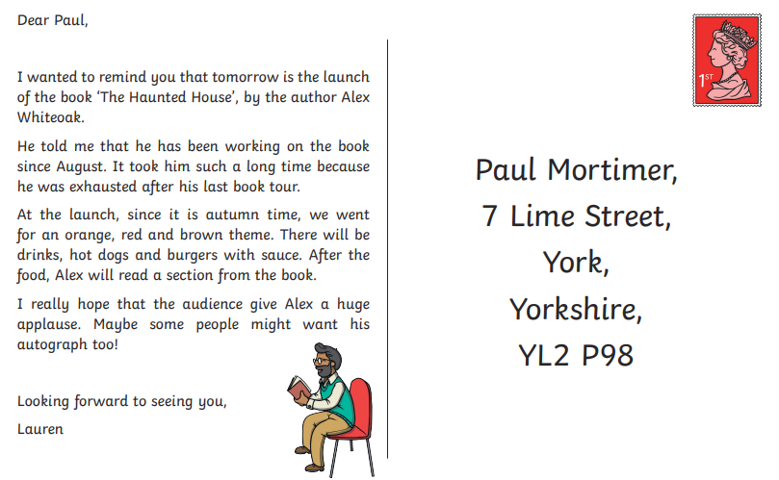
au- two letters that make one sound. This is a digraph.
Can you find all of the
‘au’ sounds in the postcard?

Slide 6
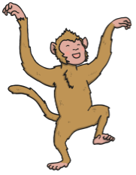
ey- two letters that make one sound.
ey makes the same sound as ee and ea.
Can you sound out these words?
monkey jockey
trolley chimney
key donkey

Slide 7
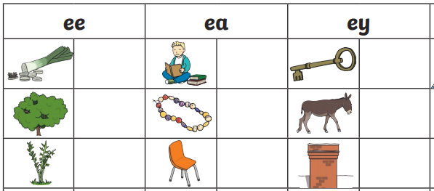
ey- two letters that make one sound.
Can you write each of these words using the different ee/ea/ey sounds?

Slide 8
ey- two letters that make one sound.
leek read key
tree bead donkey
weed seat chimney

Slide 9
Sight words- words that we need to know by looking, we can not sound them out, they break the rules.
when
come
some
what
their
people
Mr
Mrs

Slide 10
Sight word splat- Ask your grown up to say a sight word and see how quickly you can point to it.
little one when
come some Mr
what Mrs
their people

Slide 11
Useful website games:
https://www.phonicsplay.co.uk/resources/phase/3/buried-treasure (phonics play, buried treasure. Choose phase 5 and select the sounds we have learnt this week. username: march20, password: home)
https://www.phonicsplay.co.uk/resources/phase/3/flashcards-speed-trials (phonics play, username: march20, password: home, flashcards speed trial, phase 3)
https://www.phonicsplay.co.uk/resources/phase/3/tricky-word-trucks (phonics play, username: march20, password: home, tricky word trucks, pick individual words, tick all phase 3)

