Slide 1
Year 1 Phonics
Focus sounds:
au ey

Slide 2
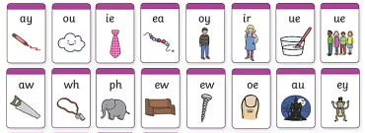
Can you still…
Sound out each of these:

Slide 3
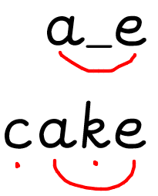
a_e- two letters that make one sound. This is a split digraph.
A split digraph is two letters that make one sound with a letter in between.
snake tape flame
Sound buttons look different with split diagraphs. Have a go at writing the words above with sound buttons like we have with ‘cake’.

Slide 4
o_e- two letters that make one sound. This is a split digraph.
home rose phone note
Hide your screen and see you if you can write each word segmenting the sounds you hear.
Challenge: Can you write a sentence using one of these o-e words?

Slide 5
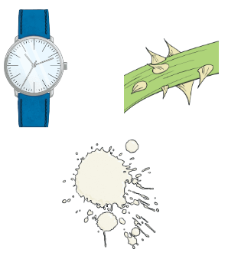
i_e- two letters that make one sound. This is a split digraph.
A split digraph is two letters that make one sound with a letter in between. Can you sound out these i_e sound words?
time white
spike inside
slide line

Slide 6
Split digraph hunt
Label a piece of paper with four sections.
Look through magazines or newspapers to find split digraph words.
Cut them out and stick them in the right section.

Slide 7
Sight word splat- Ask your grown up to say a sight word and see how quickly you can point to it.
little one when
come some Mr
what Mrs
their people

Slide 8
Useful website games:
https://www.phonicsplay.co.uk/resources/phase/3/buried-treasure (phonics play, buried treasure. Choose phase 5 and select the sounds we have learnt this week. username: march20, password: home)
https://www.phonicsplay.co.uk/resources/phase/3/flashcards-speed-trials (phonics play, username: march20, password: home, flashcards speed trial, phase 3 or 5)
https://www.phonicsplay.co.uk/resources/phase/3/tricky-word-trucks (phonics play, username: march20, password: home, tricky word trucks, pick individual words, tick all phase 3 or 5)

