Slide 1
Year 1 Phonics
Focus:
Recap phase 5

Slide 2
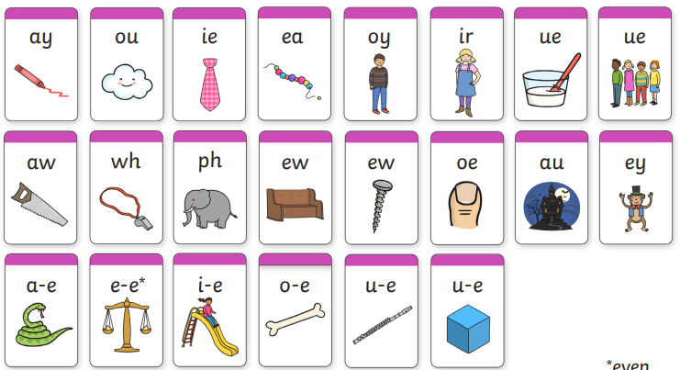
Can you still…
Sound out each of these:

Slide 3
Monday
ay, ou, ie, ea, oy,
Can you write a word for each of the sounds? If you are stuck, use the pictures below.
Challenge- Can you write a sentence using one of your words?

Slide 4
Monday
Read the words in the baubles. Copy the real words in green and the fake words in red.

Slide 5
Tuesday
ir, ue, aw, wh, ph
Can you write a word for each of the sounds? If you are stuck, use the pictures below.
Challenge- Can you write a sentence using one of your words?

Slide 6
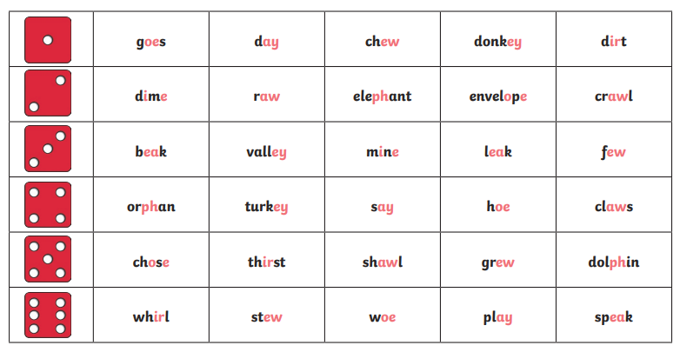
Tuesday
Roll and read. Roll a dice and read all of the words on that line.

Slide 7
Wednesday
ew, oe, au, ey
Can you write a word for each of the sounds? If you are stuck, use the pictures below.
Challenge- Can you write a sentence using one of your words?

Slide 8
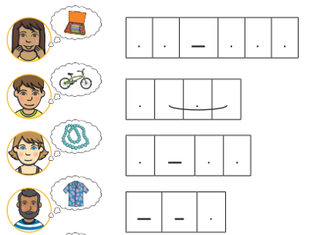
Wednesday
Can you help write the wish list in time for Christmas?

Slide 9
Wednesday
Can you help write the wish list in time for Christmas?
c r ay o n s
b i k e
b ea d s
sh ir t

Slide 10
Thursday
a-e, e-e, i-e, o-e, u-e
Can you write a word for each of the sounds? If you are stuck, use the pictures below.
Challenge- Can you write a sentence using one of your words?
(even)

Slide 11
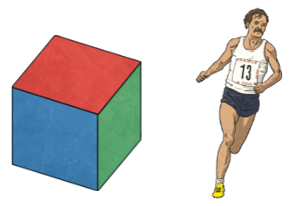
Thursday
Write what you see in each picture. Each one contains a split digraph.

Slide 12
Thursday
Write what you see in each picture. Each one contains a split digraph.
cake snake phone
cube athlete slide

Slide 13
Sight word hunt
Count how many split digraphs you can find in a book. Make a list of the words.
Challenge: Can you use any in a sentence? Tell your sentence to your grown up.
your here Mr their Mrs people

Slide 14
Useful website games:
https://www.phonicsplay.co.uk/resources/phase/3/buried-treasure (phonics play, buried treasure. Choose phase 5 and select the sounds we have learnt this week. username: march20, password: home)
https://www.phonicsplay.co.uk/resources/phase/3/flashcards-speed-trials (phonics play, username: march20, password: home, flashcards speed trial, phase 3 or 5)
https://www.phonicsplay.co.uk/resources/phase/3/tricky-word-trucks (phonics play, username: march20, password: home, tricky word trucks, pick individual words, tick all phase 3 or 5)

