Slide 1
Year 1 Phonics
Focus sounds:
ear, air, ure

Slide 2
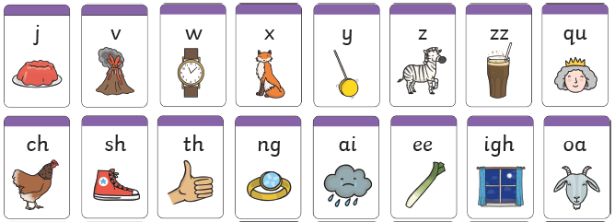
Can you still…
Sound out each of these:

Slide 3
ear- three letters that make one sound. This is a trigraph.

Slide 4
air- three letters that make one sound. This is a trigraph.

Slide 5
ure- three letters that make one sound. This is a trigraph.
Chose one to put into a sentence.
Remember: capital letter, finger space, full stop.

Slide 6
ear, air, ure

Slide 7
ear, air, ure

Slide 8
Useful website games:
https://www.phonicsplay.co.uk/resources/phase/3/buried-treasure (phonics play, username: march20, password: home, phase 3, buried treasure, revise all).
https://www.phonicsplay.co.uk/resources/phase/3/flashcards-speed-trials (phonics play, username: march20, password: home, flashcards speed trial, phase 3)
https://www.phonicsplay.co.uk/resources/phase/3/tricky-word-trucks (phonics play, username: march20, password: home, tricky word trucks, pick individual words, tick all phase 2 and 3)

