Slide 1
Year 1 Phonics
Focus sounds:
ir, oy, ue, aw

Slide 2
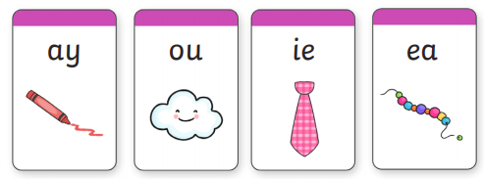
Can you still…
Sound out each of these:

Slide 3
ir- two letters that make one sound. This is a digraph.
dirt skirt shirt bird
Hide your screen and see you if you can write each word segmenting the sounds you hear. Do not forget digraph ir.

Slide 4
oy- two letters that make one sound.
royal boy toy
oy is the same sound as oi.

Slide 5
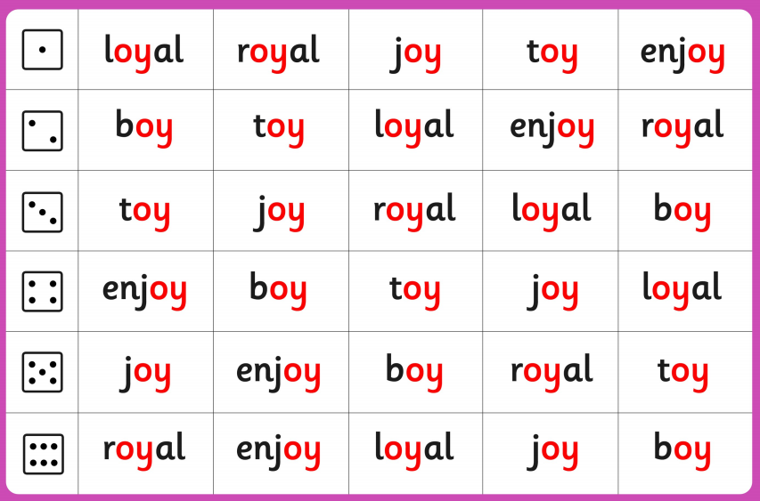
oy- two letters that make one sound.
Phase 5 roll and read.

Slide 6
ue- two letters that make one sound.
Can you sound the words below?
glue rescue statue
clue blue true
ue is the same sound as .

Slide 7
ue- two letters that make one sound.
Can you find all of the
‘ue’ sounds in the postcard?

Slide 8
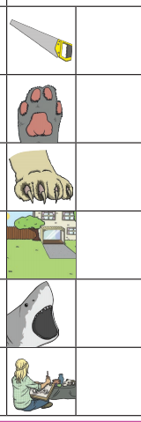
aw- two letters that make one sound. This is a digraph.
saw
paw
claw
jaw
draw
Chose one to put into a sentence.
Remember: capital letter, finger space, full stop.

Slide 9
Useful website games:
https://www.phonicsplay.co.uk/resources/phase/3/buried-treasure (phonics play, username: march20, password: home, phase 3, buried treasure, revise all).
https://www.phonicsplay.co.uk/resources/phase/3/flashcards-speed-trials (phonics play, username: march20, password: home, flashcards speed trial, phase 3)
https://www.phonicsplay.co.uk/resources/phase/3/tricky-word-trucks (phonics play, username: march20, password: home, tricky word trucks, pick individual words, tick all phase 2 and 3)

