Slide 1
Year One English w/c 19.10.20

Slide 2
This week we are recapping phonic and sentence structure

Slide 3
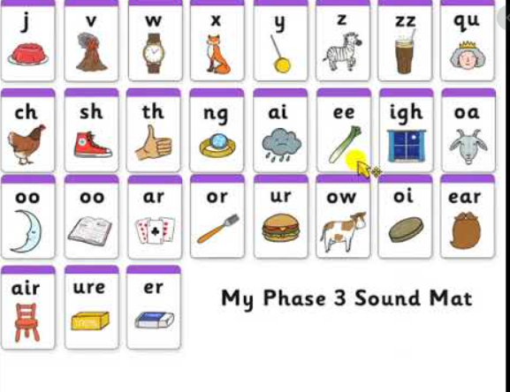

Slide 4
Can you think of some words with these sounds?
Rain
Tree
Park
Can you write these into sentences?

Slide 5
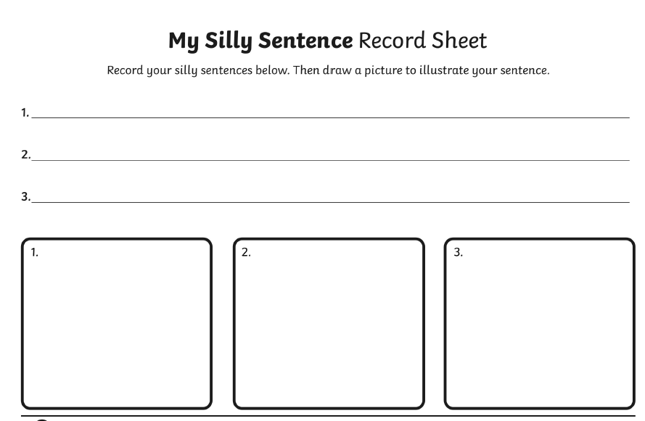

Slide 6
https://www.phonicsplay.co.uk/

