Slide 1
Year One English w/c 12.10.20

Slide 2
This week we are going to be Scientist

Slide 3
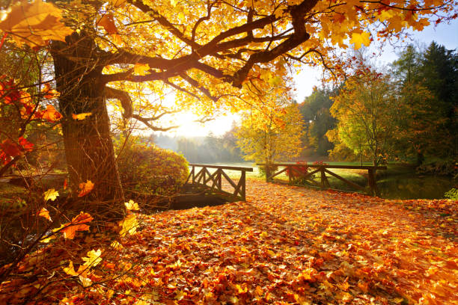
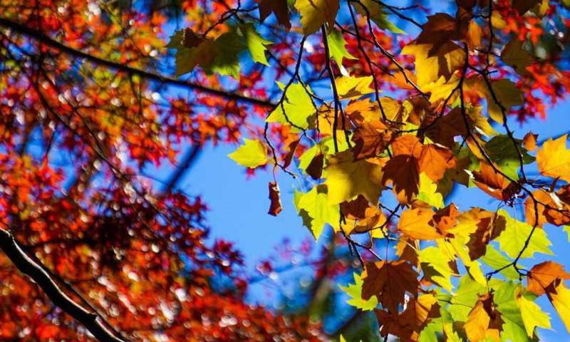
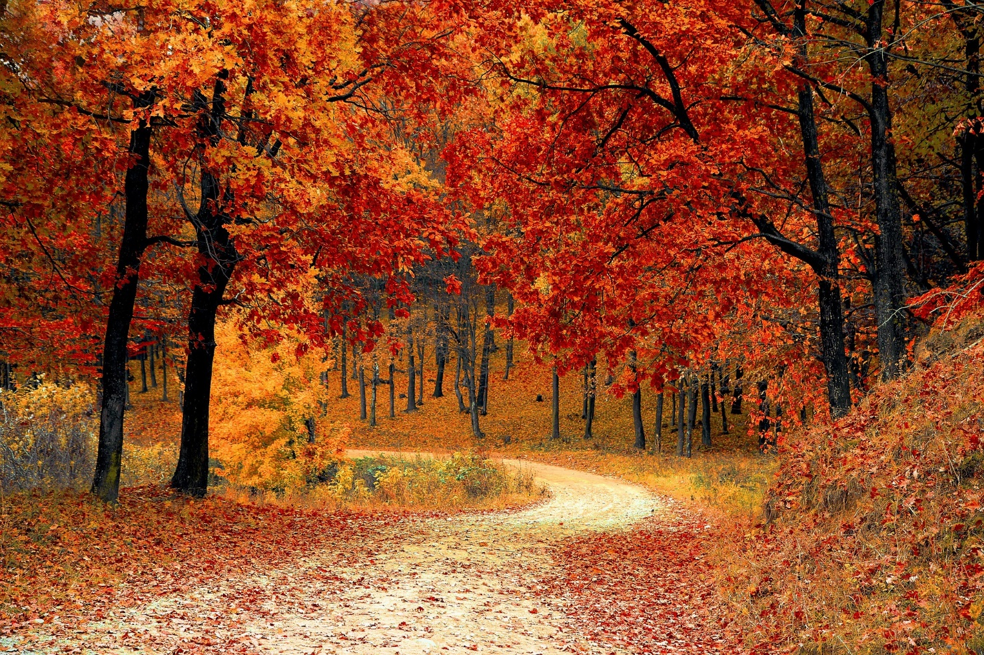
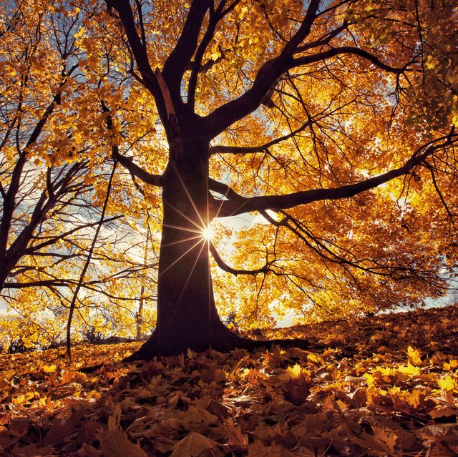

Slide 4
I can see leaves falling on the ground. I can see conkers on the floor.

Slide 5
See the weather PowerPoint

Slide 6
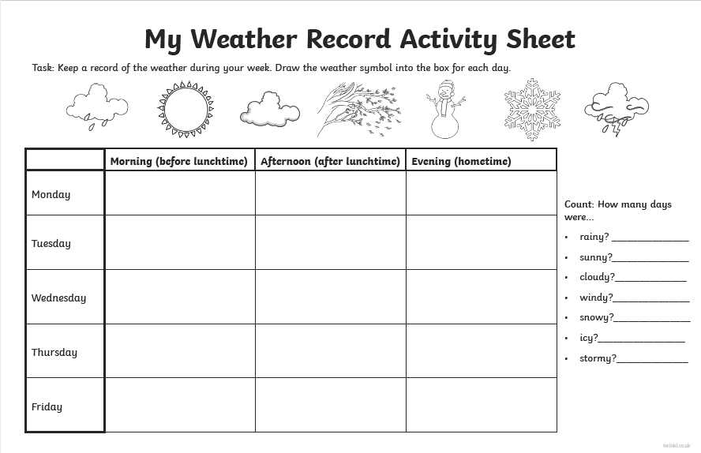

Slide 7
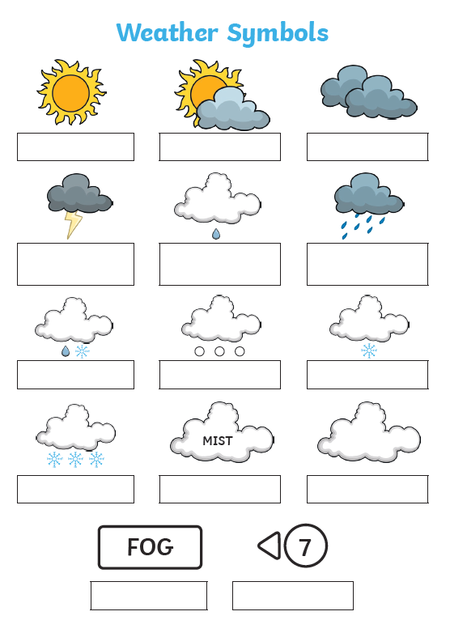

Slide 8
